Slide 1
Comparative survey data on wealth from the Luxembourg Wealth Study
19th Winter School on Inequality and Social Welfare Theory January 7-9, 2026 – Alba di Canazei
Teresa Munzi & Philippe Van Kerm

Slide 2
Contents
LIS and its Databases
Wealth data and LWS
Illustrations
Data access and research opportunities
Notes:
Originally focused on income and high-income countries, LIS has gradually expanded its coverage to:
middle- (since the 2000’s – still on-going) and low-income countries (recently)
wealth data (since mid ‘90s): LWS Database.

Slide 3
Contents
LIS and its Databases
Wealth data and LWS
Illustrations
Data access and research opportunities
Notes:
Originally focused on income and high-income countries, LIS has gradually expanded its coverage to:
middle- (since the 2000’s – still on-going) and low-income countries (recently)
wealth data (since mid ‘90s): LWS Database.

Slide 4
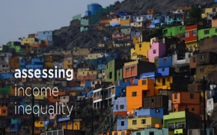
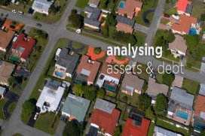
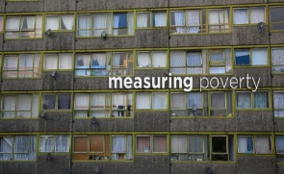


LIS history in a nutshell
Founded in 1983 out of the need to compare income distributions across countries
Currently directed by Peter Lanjouw and Philippe Van Kerm, LIS’ main strategy and priorities are set by a board of experts from all participating countries (currently presided by François Bourguignon)
Two LIS Satellite Offices
US LIS Satellite Office @ Stone Centre on Socio-Economic Inequality (CUNY, New York)
UK LIS Satellite Office @ International Inequalities Institute (LSE, London)
Supported by Luxembourg government, US NSF, and UK ESRC, and other national or supranational funders – supplemented by project-specific grants
Notes:
Which welfare state policies work in order to protect risk groups, e.g. which public and private transfers provide income in old age?
What is needed to compare well income data across countries?

Slide 5





What we do at LIS
LIS Key Figures
LIS
LIS
LISSY
Data
acquisition
2. Data
harmonisation
3. Data
dissemination
Notes:
There are three main activities that we undertake in the LIS Luxembourg office.
No, we do not collect our own data… we obtain it mostly from national statistical offices that routinely collect surveys and administrative data for monitoring and research purposes. We have to make sure that data is good quality, contains needed information and is representative of the whole country.
The data often comes in different shapes and forms. It may have a different structure and different variables, and some of the variables may be based on different definitions. For example, education is often grouped based on the national qualification systems and to make it comparable, we need to transform it into a standard form to make sure that the same category means roughly the same in every country. This process is called harmonization, and its outcome is a number of datasets with the same variable names and comparable definitions.
Finally, we have to make sure that the data can be accessed by researchers and general public. We provide key LIS figures, such as Gini coefficient for income inequality and poverty, on our website that can be viewed by everyone, and we also make the data available to researchers through a remote access system LISSY.
Steps to data harmonization
Step 1. Identify appropriate datasets.
Datasets, mostly based on household surveys, must be nationally-representative and high quality.
* Income datasets must contain detailed income data that are both comprehensive (from market and state) and disaggregated.
* Wealth datasets must contain detailed/disaggregated wealth data.
Step 2. Negotiate with national data providers.
Negotiation can take minutes to years (… to never).
Step 3. Acquire, harmonize, and document data.
LIS’ data team harmonizes the microdata using common, cross-national templates – following Canberra and other international classification systems – and creates comprehensive documentation.
Step 4. Double-check harmonized data and create national-level indicators.
Step 5. Make harmonized microdata available to researchers via “remote execution” and provide access to aggregated data

Slide 6
Overview of the LIS Databases
Two cross-national harmonised databases that allow international comparative research using micro-data:
Luxembourg Income Study Database - LIS (focus on income): 1,016 datasets from 53 countries – from the late 1960s to 2024
Luxembourg Wealth Study Database - LWS (focus on wealth): 133 datasets from 24 countries - from 1991 to 2024
Under construction:
Luxembourg Consumption Study Database - LCS (focus on consumption): public release in 2027
Notes:
Originally focused on income and high-income countries, LIS has gradually expanded its coverage to:
middle- (since the 2000’s – still on-going) and low-income countries (recently)
wealth data (since mid ‘90s): LWS Database.

Slide 7
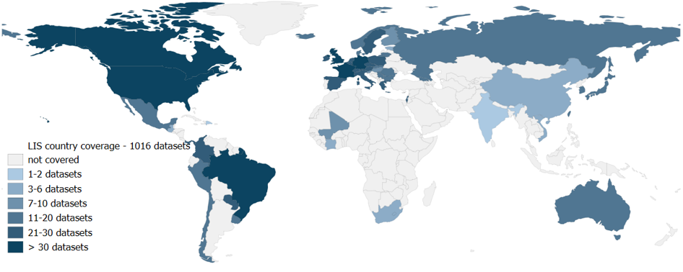
Luxembourg Income Study (LIS) Database Country coverage by December 2025

Slide 8
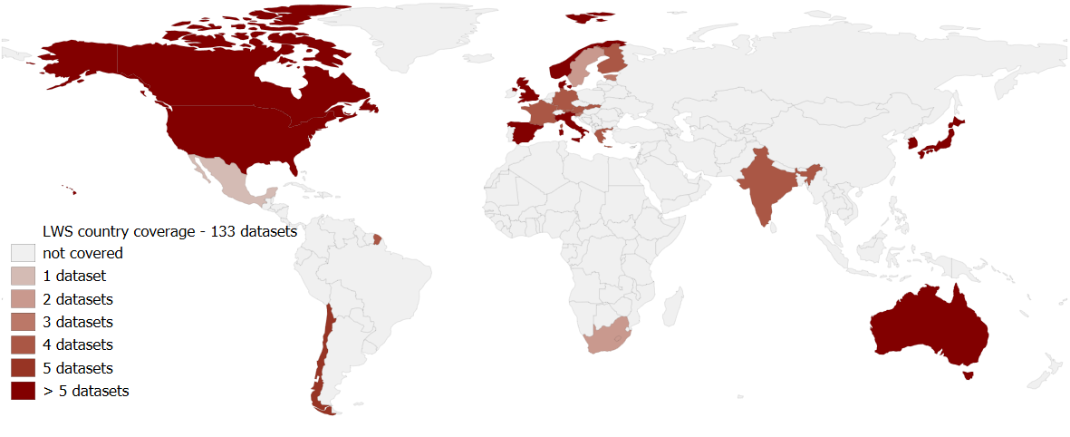
Luxembourg Wealth Study (LWS) Database Country coverage by December 2025

Slide 9
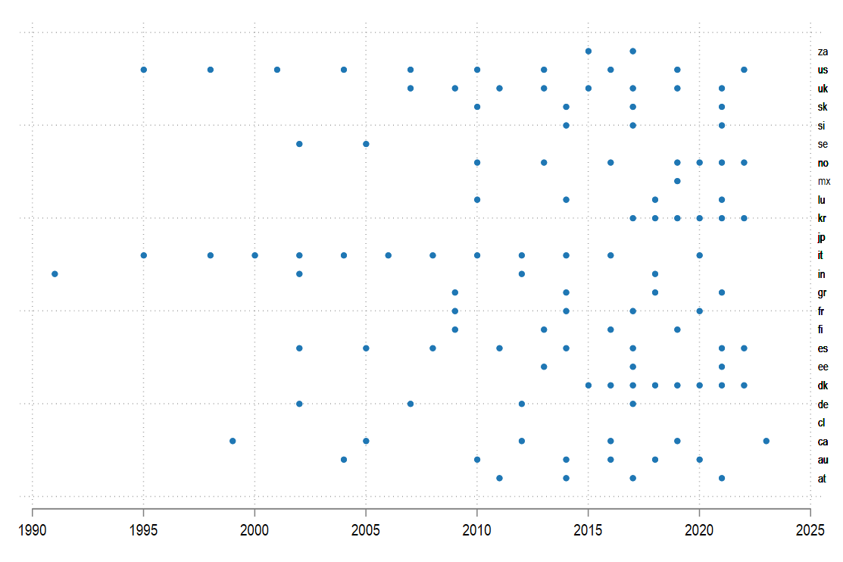
LWS Coverage

Slide 10
LWS Database

Slide 11
Contents
LIS and its Databases
Wealth data and LWS
Illustrations
Data access and research opportunities
Notes:
Originally focused on income and high-income countries, LIS has gradually expanded its coverage to:
middle- (since the 2000’s – still on-going) and low-income countries (recently)
wealth data (since mid ‘90s): LWS Database.

Slide 12
Why wealth data matters?
Wealth is a core pillar of well-being, alongside income and consumption. It enables households to meet basic needs, access healthcare, and invest in education
Wealth generates economic and social advantages: It provides returns, facilitates access to credit, enhances social influence, and acts as a safety net
Key to resilience in volatile contexts: wealth determines which households can cope with adverse shocks and which fall into deprivation
Policy relevance:
Helps identify vulnerable groups for poverty profiling and targeting of social protection
Used to assess tax capacity and design wealth or property taxation
Macro-economic importance: wealth distribution matters for central banks—interest rates affect asset values, debt sustainability, and consumption responses
Research and program design:
Enables analysis of poverty, inequality, social mobility, and intergenerational transfers
Supports evaluation of tax and social policies and anticipation of distributional impacts
Critical where aggregate wealth statistics are missing

Slide 13
Complexities in measuring wealth
Methods for wealth evaluation
Value of non-financial assets
Valuation of pension assets
Valuation of informal assets of liabilities
Date on which the evaluation is made
”Contingent” or potential assets and liabilities
Risk of double-counting assets reported at the individual level

Slide 14
Measuring and comparing wealth
▸ Several issues make the harmonisation and comparability of wealth data across countries challenging:
▸ collection of household wealth statistics
▸ measurement of wealth (complexities for wealth evaluation)
▸ availability of the components of wealth
▸ classification of subcomponents of wealth
▸ definition of wealth
importance of converging towards common international standards
▸ LWS Database attempts to provide a common framework to mitigate the issues arising from the limited comparability of the data
Notes:
While these issues could be fully resolved only through internationally agreed standards and guidelines that countries and data producers are willing to follow, the LWS Database attempts to provide a common framework to mitigate the issues arising from the limited comparability of the data

Slide 15
LWS Database: Overview
▸ harmonised microdata from surveys, administrative records or a combination of the two
▸ information on:
▸ socio-demographics
▸ household composition
▸ household income and consumption
▸ labour market information
▸ household balance sheets (assets and debts)
▸ contingent assets and liabilities
▸ assets acquired in the past
▸ attitudes toward household finance
▸ other behavioral variables

Slide 16
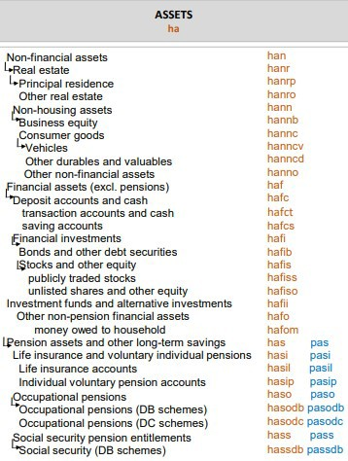
Assets
Non-financial assets
Financial assets

Slide 17
Assets
Business equity: assets held by private business - financial liabilities held against these assets
how much the business could be sold for (market value of business equity)
only variable that records the value of net assets
Pension assets:
very difficult to measure value of assets based on PAYG systems (as against funded systems), especially if defined benefit → social security and occupational pension entitlements often not collected
differences in the measurement of pension assets → breakdown in individual, occupational, and social security pensions as well as DB vs. DC schemes
if pension assets are not collected or computed, variables HA=HAS=0
comparisons between countries are very much dependent on different
pension systems, and reforms
32 / 80

Slide 18
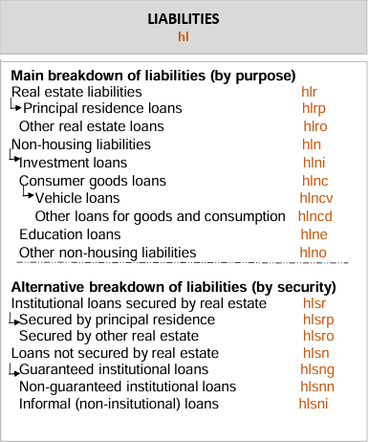
Liabilities
Liabilities by purpose grouped by purpose for which the debt was taken (e.g. car, principal residence, etc.)
Liabilities by security grouped by secured status of debt (e.g. whether or not debts are secured against assets and type of asset held as security)

Slide 19
Liabilities
Contingent liabilities (possible obligations, for which it has yet to be confirmed whether the household has a present obligation that might lead to an outflow of income) are excluded from the measurement of household wealth
Informal liabilities are often difficult to measure (or unclear whether they should be included)

Slide 20
Various concepts of net worth
▸ 4 measures of net worth:
▸ disposable net worth (DNW) – always filled, excludes pension assets and other long-term savings (HAS)
▸ adjusted disposable net worth (ANW) – only filled if life insurance and individual pension assets (HASI) are available
▸ integrated net worth (INW) – only filled if total value of occupational pensions (HASO) or its subcomponents are available - in some cases equal to TNW
▸ total net worth (TNW) only filled when all pension assets are available
▸ Which measure of net worth shall be used?
The most comprehensive (TNW) is less widely available. It depends also on research purpose and on whether less liquid assets should be taken into consideration

Slide 21
LWS specific non-wealth variables
▸ Contingent assets, liabilities and related variables
▸ expectations of inheritances
▸ home equity line of credit
▸ non-home equity line of credit
▸ Assets acquired in the past
▸ inheritance (how much, what, from whom, when)
▸ principal residence (purchase price, year)

Slide 22
LWS specific non-wealth variables: behavioral variables
▸ Attitudes toward household finance
▸ savings
▸ risk taking
▸ financial planning, literacy, information
▸ Other behavioral variables
▸ credit cards, loan consolidation
▸ objective/subjective credit constrains
▸ Most of the variables do not have standardized content (“c”) and available only for the household head /respondent
▸ Currently limited coverage, but expansion in the future can be expected

Slide 23
Structure of the LWS datasets
▸ Household level file
▸ uniquely identified by the household identifier and the implicate number (variables HID, and INUM)
▸ Individual level file
▸ uniquely identified by the household identifier, the person identifier, and the implicate number (variables HID, PID, and INUM)
▸ Replicate weights file
▸ uniquely identified by the household identifier (variable HID)

Slide 24
Replicate weights file
Replicate weights allow users to generate empirically derived standard error estimates
These standard errors can then be used to obtain more precise confidence intervals and significance tests
Link to oversampling of the rich
In LWS, depending on country data, this file contains
either no replicate weights (but it still exists)
or as many as the data producer has created (up to 1,000)
it includes exactly one observation for each household of the sample
Notes:
Replicate weights allow a single sample to simulate multiple samples, thus generating more informed standard error estimates that mimic the theoretical basis of standard errors while retaining all information about the complex sample design

Slide 25
Non-response: weighting adjustments
How do I use replicate weights?
▸ Stata can process replicate weights automatically
▸ First svyset the data
▸ The full-sample weight must be specified
▸ Then specify the replicate weights
▸ Also specify the variance-covariance estimators (VCE) option (e.g. bootstrap, jackknife, linearized, etc.)
▸ svyset [pw=FullSampleWeight], /// bsrweight(replicatewgt1-replicatewgt999) vce(bootstrap)

Slide 26
Missing data and multiple imputation
Why use multiply imputed data?
▸ Multiple imputation yields multiple outcomes from a random process, it supports more efficient estimation than
singly-imputed data
▸ Multiple imputation allows users to make straightforward estimates of the degree of uncertainty associated with the missing information
▸ Be cautious in the treatment of the implicates while estimating regressions. Many regression packages will treat each of the five implicates as an independent observation and correspondingly inflate the reported significance of results

Slide 27
Multiple imputations in the LWS datasets
▸ multiple imputation procedure imputes missing values yielding multiple outcomes from a random process
▸ the imputations are stored as 5 successive implicates of each record (variable INUM ranges from 1 to 5)
the number of observations in the file is 5 times the actual number of households and individuals
Notes:
Be cautious in the treatment of the implicates while estimating regressions. Many regression packages will treat each of the five implicates as an independent observation and correspondingly inflate the reported significance of results

Slide 28
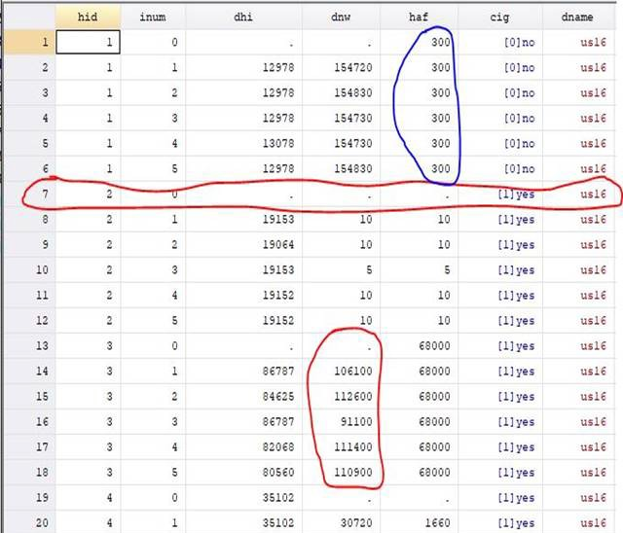
Typical structure of wealth data

Slide 29
Unit of analysis
▸ Preferred unit for wealth statistics: household
▸ However, some particular types of wealth analysis may target individual persons, since the intra-household distribution of resources can be very unequal and average household size and composition vary considerably, particularly between population sub-groups and across countries
▸ Where there is interest in analyzing wealth data on the basis of the number of persons in households with particular characteristics, the unit of analysis is the person and person-weighted estimates are needed

Slide 30
Equivalising wealth
No internationally agreed equivalence scale exist for wealth
Key Point: Equivalising wealth does not behave like equivalising income and can distort results
Why Wealth Is Different
Wealth is a stock, not a flow → unclear how “needs” scale with household size
Housing wealth already reflects household-size needs
Dividing by an equivalence scale mechanically pushes singles upward and compresses inequality
Main Consequences
Median wealth rises artificially
Inequality shrinks mechanically, driven by the scale - not by real differences
Results become highly sensitive to the chosen equivalence scale
Practice Recommendation
Most analyses do not equivalise wealth
If used, scales must be justified, and results should be interpreted with caution
Notes:
Equivalence scales should not be used when analyzing the characteristics of individual components of wealth
If wealth is treated as a source of income streams that can be used to finance consumption and contribute to economic wellbeing in the household, wealth might be equivalized just as income
In studies jointly analyzing income and wealth, the equivalence scale applied to income is also applied to wealth (OECD work)

Slide 31
Contents
LIS and its Databases
Wealth data and LWS
Illustrations
Data access and research opportunities
Notes:
Originally focused on income and high-income countries, LIS has gradually expanded its coverage to:
middle- (since the 2000’s – still on-going) and low-income countries (recently)
wealth data (since mid ‘90s): LWS Database.

Slide 32
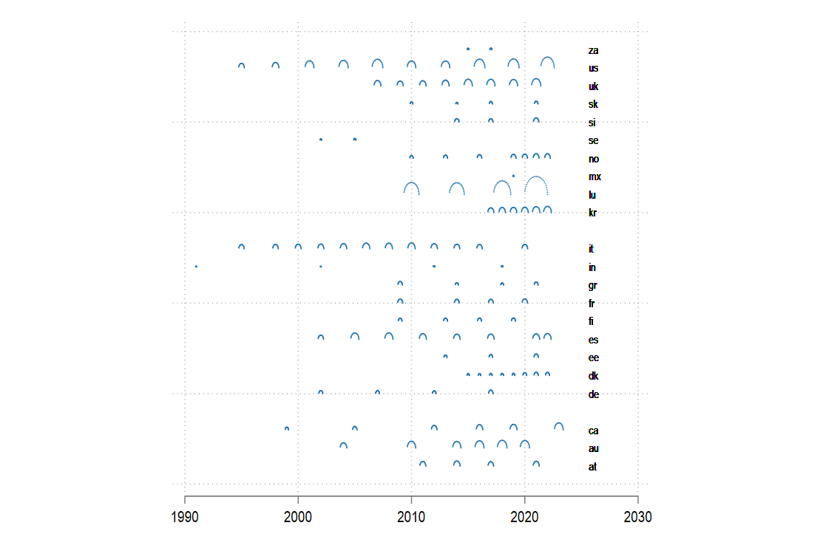
Mean wealth in LWS countries (in PPP)

Slide 33
Income vs wealth inequality
Lorenz curve for income and wealth – South Africa, Norway, Chile and USA
disposable net worth
disposable income
Notes:
Norway: The Lorenz curve is below zero up to the 45th percentile — meaning the bottom 45% of households together hold negative net wealth.
Nearly half of the population is, in net terms, indebted.

Slide 34
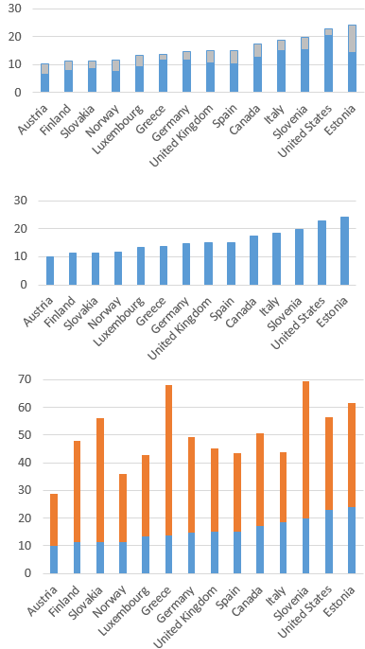
Combining income and asset poverty
Income poor AND asset poor
Income poor
Income poor OR asset poor
reduced by ‘vulnerable’ group 2
income poor, but not asset poor
extended by ‘vulnerable’ group 1
asset poor, but not income poor
Notes:
Asset poor: who do not have sufficient financial assets to cover consumption for at least 3 months

Slide 35
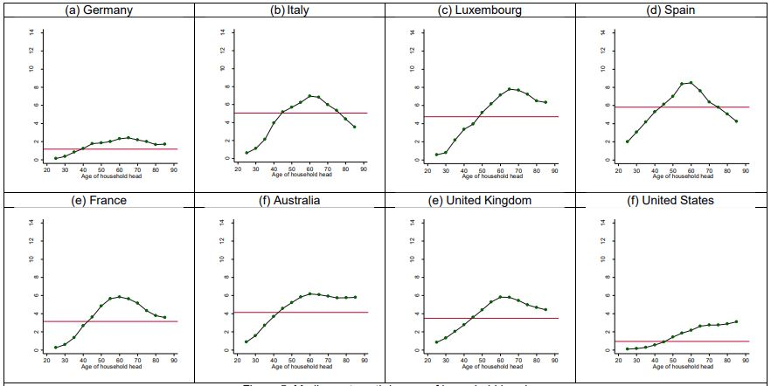
Wealth accumulation over life cycle
Median net worth by age of household head Cowell et al. (2019)
Estimates obtain by kernel smoothing; red line represents the population median

Slide 36
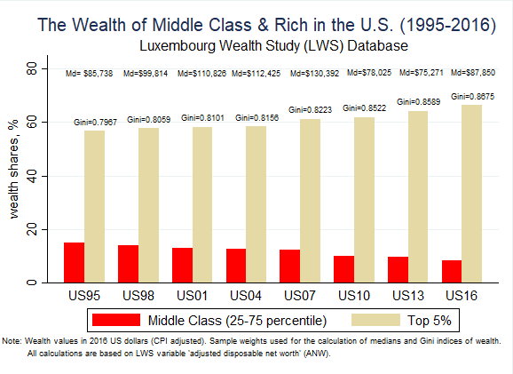
Wealth and the middle class

Slide 37
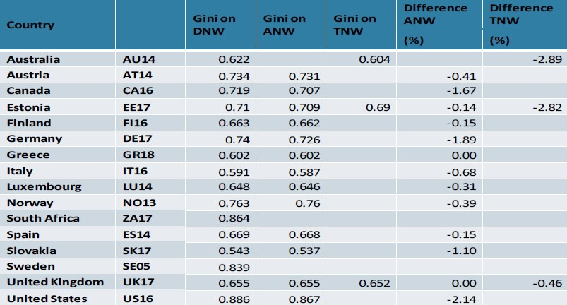
Impact of inclusion of pensions on Gini index

Slide 38
Why LWS data?
▸ The subject of household finance is still novel! But the number of published papers (in Q1 journals) is growing rapidly!
▸ There is still a need for a comprehensive understanding of households’ financial stability
▸ distributional analyses on household assets and liabilities
▸ Users of LWS data jointly assess multiple dimensions of household economic well-being, namely wealth, income, and (in some datasets) consumption!
▸ Many topics are still to be further researched (e.g., asset and income poverty, behavioral aspects of household financial decision-making)
▸ ”Lack of income means you don’t get by; lack of assets means you don’t get ahead.“ (Sherraden, 1991)
Notes:
income protects against immediate hardship, while assets enable long-term progress

Slide 39
Contents
LIS and its Databases
Wealth data and LWS
Illustrations
Data access and research opportunities
Notes:
Originally focused on income and high-income countries, LIS has gradually expanded its coverage to:
middle- (since the 2000’s – still on-going) and low-income countries (recently)
wealth data (since mid ‘90s): LWS Database.

Slide 40
Accessing LWS data
a remote execution system (LISSY) enables the use of our data around the world (an average of 1,000 researchers & students submit about 100,000 jobs remotely every year)
free access for students, data providers and their staffs in all countries
free access for researchers, and assimilated staff of non-profit organization or governmental organizations from contributing member countries

Slide 41
Research opportunities at LIS
(LIS)²ER visiting scholars grants
Research Stays: individual researchers of all seniority levels (or small teams of researchers) interested in spending between 2 and 8 weeks the LIS-LISER premises in Luxembourg
Forthcoming events:
June 29-July 3 2026: LIS Summer Workshop + Summer Lecture (Frank Cowell), Luxembourg
During 2026: call for papers for the first LCS conference
February 2027: LIS-III conference on comparative inequality, LSE, London

Slide 42
Thank you for your attention!

