Slide 1
Equality of opportunity and policy preferences in transition economies
Twelfth Winter School on
Inequality and Social Welfare Theory
Alba di Canazei
December 9-12, 2017
Vito Peragine (University of Bari)

Slide 2
The reading list
1. Equality of opportunity
Ferreira, F.H.G., Peragine, V. (2016). Individual responsibility and equality of opportunity, in M. Adler and M. Fleurbaey (eds.), Handbook of Well Being and Public Policy, Oxford: Oxford University Press.
Available at: http://documents.worldbank.org/curated/en/382131467998206429/pdf/WPS7217.pdf
Roemer, J.E., A. Trannoy (2015). Equality of opportunity, in A.B. Atkinson and F. Bourguignon (eds). Handbook of Income Distribution, vol.2B, Amsterdam: North Holland.
Available at: https://milescorak.files.wordpress.com/2015/10/roemer-trannoy-equality-of-opportunity-theory-and-measurement-journal-of-economic-literature-forthcoming.pdf
2. Equality of opportunity and policy preferences
M. Brock (2016) “Inequality of opportunity and beliefs about success and failure”, EBRD Working Paper No. 187.
Available at: file:///C:/Users/utente/Downloads/WP_187_Inequality%20of%20opp_3.pdf
J.M. Brock, V. Peragine, S. Tonini (2016). "Inequality of opportunity”,"in “Transition for all:
Equal opportunities in an unequal world”, 2016/2017 EBRD Transition Report, Chapter 3, pp. 44-59.
Available at: http://www.ebrd.com/news/publications/transition-report/transition-report-201617.html

Slide 3
The presentation
Some (additional) thoughts on inequality of opportunity
Inequality of opportunity and policy preferences in transition economies
  Based on a background paper for the European Bank for Reconstruction and Development (EBRD) Transition Report 2016/2017.
  We estimate inequality of opportunity in the EBRD region for a set of outcome variables and we study the relationship between inequality of opportunity, individual perceptions and policy preferences.
  The analysis is based on the latest round of the Life in Transition Survey (LITS III), conducted by WB and EBRD in the second half of 2015 and the first half of 2016.

Slide 4
What is inequality of opportunity
Equality of opportunity in the indirect approach
Essence: the most ethically unacceptable inequalities are not those that reflect different levels of personal responsibility or effort, but those reflecting differences in inherited, pre-determined circumstances.
The “new” IOp literature (Roemer 1993, Fleurbaey 1994) provides :
- a unified approach
- a rigorous definition of EOp
- allocation rules and social rankings

Slide 5
How to model and measure inequality of opportunity?
An indirect method: since we do not observe “opportunities”, we have to rely on what is observable: outcomes and circumstances, and sometime effort.
The “canonical model”:
    x = g(C, e)
Compensate the effect of C (compensation principle)
How to apportion outcome to responsibility? (reward principle)

Slide 6
Why does inequality of opportunity matter?
Because it is intrinsically unfair.
  Rawls (1971), Sen (1980), Dworkin (1981)
Because it is perceived as unfair (Cappelen et al. 2010), and perceptions matter: they might affect both political and economic behaviour.
  Inequality of opportunity, more than income inequality, might affect the individual preferences for redistribution (Alesina and La Ferrara, 2005; Brock et al. 2016)
Because it may generate inefficiencies and may reduce the potential for growth.
  World Bank (2006), Marrero and Rodriguez (2013), Ferreira et al. (2014).

Slide 7
Opportunities vs outcomes
Different distributional criteria, different social rankings
Conflict?
Combine opportunity egalitarianism with other distributional criteria
    EOp and avoidance of extreme poverty (World Bank, 2006; Hufe et al. 2017)
    Compensation and avoidance of extreme inequality within types (Peragine, 2002; Aaberge and Colombino 2012; Fleurbaey et al. 2017)
Not necessarily conflicting policy implications

Slide 8
Opportunity vs outcome egalitarian policies
x = g(C, e)
Ex ante equalization of circumstances, trough cash transfers or services:
  “Selective” education financing aimed at compensating pupils starting from different family background (Betts and Roemer, 2004) => equalizing effect on parents’ income
  income redistribution between parents => equalization of circumstances for the next generation
Ex post compensation through policies that affect outcomes:
  Affirmative action: e.g., policies addressing the gender wage gaps or other horizontal inequalities
  These policies could also reduce the outcome inequalities
The intersection between opportunity egalitarian and outcome egalitarian policies can be far from empty!
The EOp perspective can give more strenght to the egalitarian project

Slide 9
EOp is particularly relevant in Transition economies
During communism, work place, work sector and education were more or less exogenously determined.
  Did not depend much on individual effort (bad for Reward)
The transition to market economies was accompanied by expectations of greater and fairly distributed opportunities for all.
But market failures and institutional frictions may limit access to the opportunities and increase the role of exogenous circumstances:
  Together with the (desired) recognition of Reward, there is an (undesired) role played by circumstances
Inequality of opportunity can foster resentment and erode support for markets and democracy.
Need to monitor the (in)equality of opportunity.

Slide 10
The Data: Life in Transition Survey III (2016)
The only survey with comparable data on individual circumstances across the EBRD Region:
- Western Europe (Italy, Germany, Greece)
- Central Europe and Balkans (CEB): 8 countries
- South-eastern Europe (SEE): 9 countries
- Eastern Europe and the Caucasus (EEC): 6 countries
- Central Asia: 6 countries

Slide 11
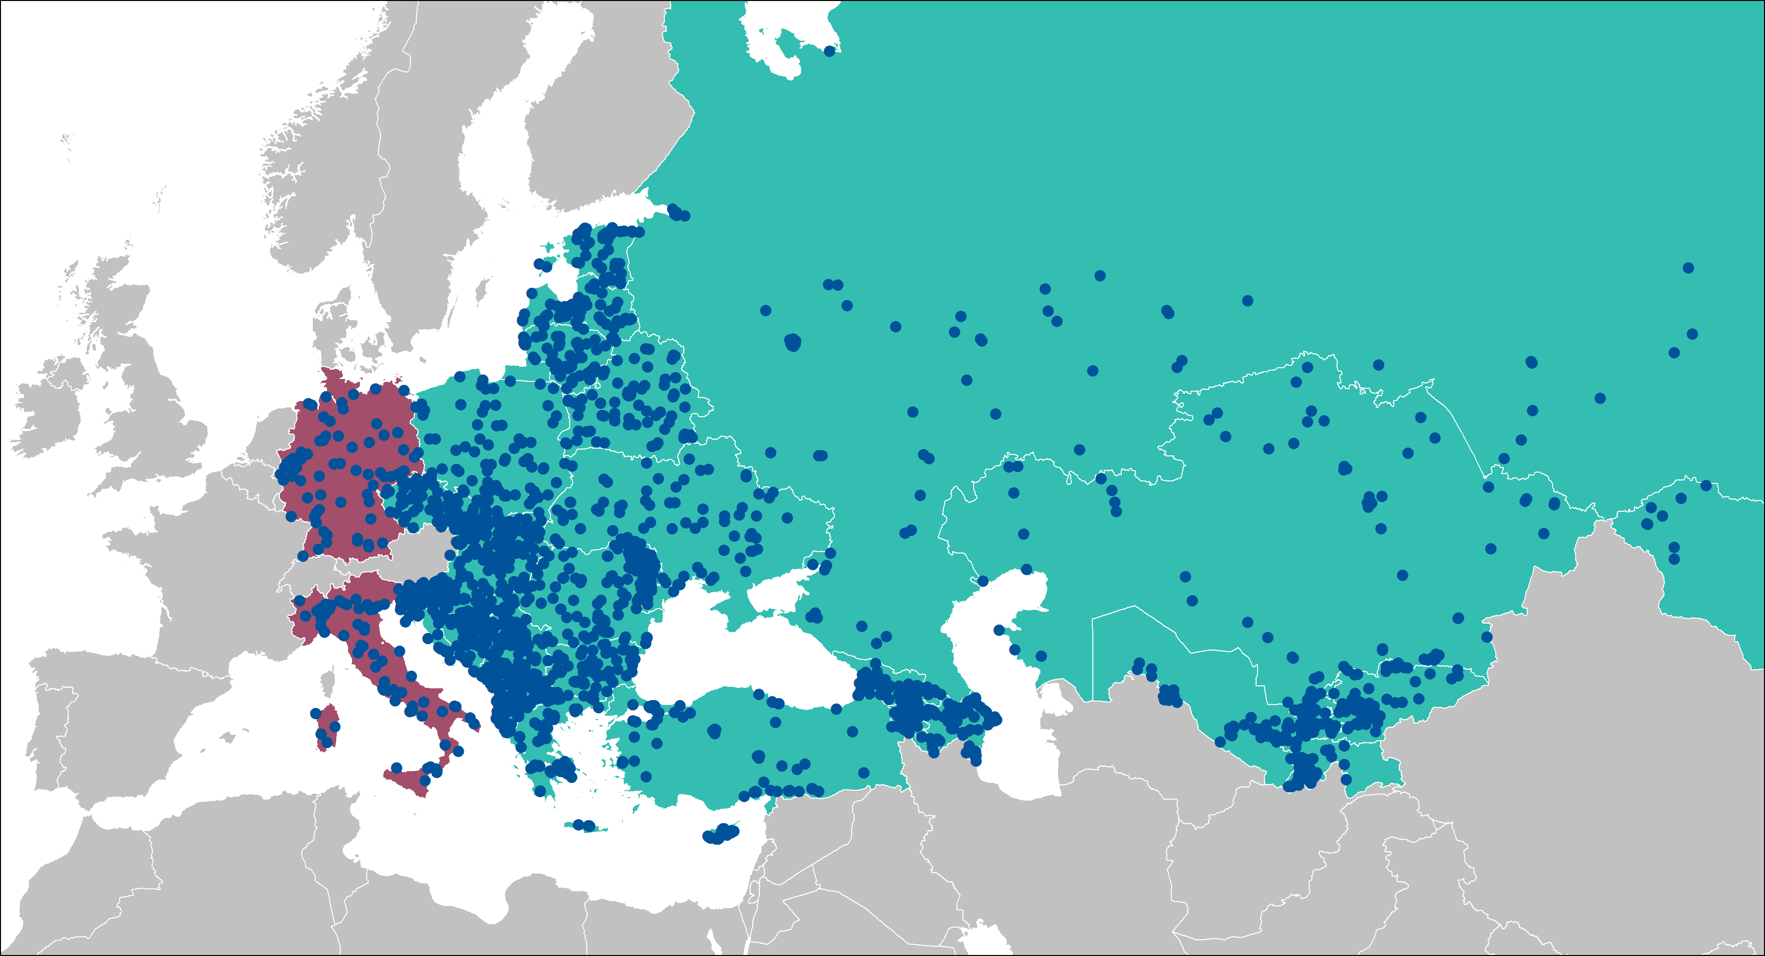
The Data: Life in Transition Survey III (2016)
51,000 respondents in 29 post-communist countries, plus Germany, Italy, Turkey, Greece and Cyprus

Slide 12
Inequality between whom?
From 18 to 64 years old
Average : 42 years old
55% Female
45% Male
41% born in rural areas
59% born in urban areas
99% has at least some education
7% has only primary education
26% has tertiary education

Slide 13
Measuring inequality of opportunity in our sample
urban birthplace
gender
parents’ education
labour force outcomes, income, wealth
parents’ work
Our Circumstances include:
gender
mother’s and father’s education
urban or rural birthplace
whether one’s mother ever worked
Our Outcomes of interest include:
individual income
individual labour market outcomes
educational attainment
Effort + Circumstances → Outcomes
whether et least one of the parents was a member of the Communist Party
(Wealth)

Slide 14
Measuring inequality of opportunity
For income (we construct the net yearly individual labour income)
=> Gini coefficient applied to the “between types” parametrically smoothed distribution
For having: a) tertiary education, b) a job in the formal sector, c) a good job (a job providing a predictable and sufficient stream of income)
=> Dissimilarity index (Paes de Barros et al. 2009)

Slide 15
Inequality of outcomes in the data

Slide 16
IOp estimates

Slide 17
IOp estimates: education

Slide 18
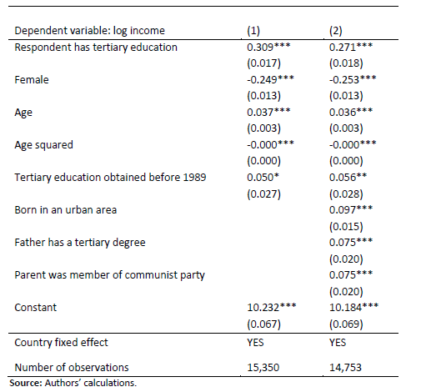
The return to tertiary education
With transition, important reform in the education system:
Tertiary education from universally free to costly;
Strong and controlled link between degree and jobs disappeared;
Transition put a premium on new skills.
The return is still high, even controlling for circumstances
But lower than in the early years of transition

Slide 19
IOp for tertiary education: older cohort (degree before 1989)

Slide 20
IOp for tertiary education: younger cohort
Circumstances matter more in the young cohort
The role of parental background rises both in absolute and relative terms (educated parents gained more from transition?)
A “reverse” gender gap, more prevalent in the young cohort

Slide 21
IOp in education: Summary
There is a substantial degree of inequality of opportunity in the higher education.
Higher IOp for the young than for the older. Parental education plays a bigger role for the younger cohort.
Education in a market economy is more costly and seen as productive investment. Thus more dependent on family background.
Notes:
GDP is too crude
Urban: need to check life satisfaction

Slide 22
IOp estimates: having a job and having a “good job”

Slide 23
IOp in employment: having a job

Slide 24
IOp in employment: having a “good” job
- IOp for a “good” job is 50% higher the IOp for any job
- parental background
- parents’ membership of Communist party is still important for having a “good” job

Slide 25
IOp in employment: Summary
Birthplace, mother’s work history and parental political networks more meaningful for jobs than they are for income.
Gender plays a bigger role in getting a job than in having a “good” one.
Parents’ education again very important.
While people with jobs may have low inequality of opportunity, access to “good” jobs is a stronger barrier.
Notes:
While people with jobs may have low inequality of opportunity, access to “good” jobs is a formidable barrier.
Gender play a surprisingly small role for access to jobs, compared to income among the employed. So we were worried about selection – people may not enter the labor market if they are not sure to get a good job. Women are risk and uncertain averse, prefer not to compete. Etc.

Slide 26
IOp estimates: income

Slide 27
Total and relative inequality of opportunity for income

Slide 28
Inequality of opportunity vs income inequality

Slide 29
Which circumstances matter?

Slide 30
Average estimates of inequality of opportunity and the role of individual circumstances
 | Tertiary education | Any job | Good job | Income
Overall inequality of opportunity | 0.25 | 0.11 | 0.16 | 0.12
Average per cent of inequality of opportunity explained per Circumstance
Parental education | 0.74 | 0.40 | 0.43 | 0.37
Birth place (urban/rural) | 0.18 | 0.18 | 0.18 | 0.16
Gender | N/A | 0.20 | 0.16 | 0.33
Ethnicity (majority/minority) | 0.03 | 0.14 | 0.12 | 0.06
Parent a member of the communist party | 0.05 | 0.08 | 0.12 | 0.08

Slide 31
Perceptions

Slide 32
Mapping IOp to policy preferences (1)
Direct channel
IOp, income inequality
wealth
income
Policy preferences
markets
labour market outcomes
redistribution
democracy

Slide 33
Mapping IOp to policy preferences (2)
Indirect channel
IOp, outcome inequality
wealth
income
Perception of own situation
where you place yourself on a ten-step ladder
Policy preferences
markets
labour market outcomes
redistribution
democracy

Slide 34
Self-perception of one’s place in the income distribution: ten step ladder
“Please imagine a ten-step ladder. On which step of the ten is your household today?”
Distribution is far from uniform
Respondents do not predict their ladder step well.
Bias toward the middle, which is stronger for the upper tail

Slide 35
A robust result
Measured consumption deciles versus answers to income ladder question (%)
Feeling poor (self assigning to ladders 1,2 or 3); about 50% of those who have consumption levels of decile 1
Frequency of the main diagonal is about 12 %
Source: Bussolo (2016)

Slide 36
Distribution of positive and negative perceptions
We use the ladder question as “perception of my own situation”
We use the discrepancy between income decile and ladder response as a measure of whether you have positive or negative views of your situation.

Slide 37
Mapping IOp to policy preferences
IOp, income inequality
household wealth
wage income
Perception of own situation
where you place yourself on a ten-step ladder, controlling for wealth
Policy preferences
markets
labour market outcomes
redistribution
democracy

Slide 38
IOp has a negative impact on individual perception
 | Does respondent have a negative outlook?
IOp income | 0.148* (0.082)
IOp employment in the formal sector |  | 0.057*** (0.013)
IOp wealth |  |  | 0.016*** (0.005)
Gini index | 0.042 (0.027) | 0.028 (0.025) | 0.050** (0.019)
Income decile | 0.951*** (0.111) | 0.952*** (0.111) | 0.951*** (0.111)
Education level | -0.189*** (0.057) | -0.191*** (.058) | -0.191*** (.058)
Gender | 0.268*** (0.068) | 0.267*** (0.069) | 0.267*** (0.069)
Age | 0.033 (0.037) | 0.033 (0.037) | 0.033 (.037)
Household head | -0.222 (0.160) | -0.191 (0.058) | 0.216 (0.159)
Country and region controls | yes | yes | yes
Observations | 11,440 | 11,440 | 11,440

Slide 39
Mapping IOp to policy preferences
IOp, income inequality
household wealth
wage income
Perception of own situation
where you place yourself on a ten-step ladder
Policy preferences
markets
labour market outcomes
redistribution
democracy

Slide 40
Policy preferences
Support for markets
(4.11) |  | With which one of the following statements do you agree most? |  |  |  |  |  | A market economy is preferable to any other form of economic system
 |  |  |  |  |  |  |  | Under some circumstances, a planned economy may be preferable to a market economy
 |  |  |  |  |  |  |  | For people like me, it does not matter whether the economic system is organised as a market economy or as a planned economy
Support for democracy
(4.12) |  | With which one of the following statements do you agree most? |  |  |  |  |  | Democracy is preferable to any other form of political system
 |  |  |  |  |  |  |  | Under some circumstances, an authoritarian government may be preferable to a democratic one
 |  |  |  |  |  |  |  | For people like me, it does not matter whether a government is democratic or authoritarian
Attitude toward redistribution
The gap between the rich and the poor in our country should be reduced | 1 | 2 | 3 | 4 | 5

Slide 41
IOp and policy preferences (1)
 | Support for markets |  | Support for democracy
 | (1) | (2) | (3) | (4)
Direct channels
Inequality of opportunity: income | -7.553*** | -7.277*** | -7.441** | -7.287**
 | (2.767) | (2.738) | (2.947) | (2.925)
Inequality of opportunity: any job | -3.702 | -3.971 | -7.834*** | -7.928***
 | (2.697) | (2.633) | (2.490) | (2.486)
Inequality of opportunity: education | -2.144 | -2.150 | -4.733** | -4.761**
 | (1.864) | (1.843) | (2.002) | (1.985)
Indirect channel
Perception of relative economic wellbeing |  | 0.076*** |  | 0.034
 |  | (0.022) |  | (0.023)
Controls
Income decile | 0.042*** | 0.034*** | 0.041*** | 0.038***
 | (0.011) | (0.011) | (0.011) | (0.011)
Gini index of income inequality | 0.049* | 0.050** | 0.103*** | 0.103***
 | (0.025) | (0.025) | (0.027) | (0.027)
Unemployment (5-year average) | -0.034** | -0.037** | -0.029 | -0.030*
 | (0.016) | (0.015) | (0.018) | (0.017)
GDP growth (5-year average) | 0.099* | 0.102* | 0.007 | 0.010
 | (0.052) | (0.053) | (0.049) | (0.049)
Level of democracy (polity2) | 0.065*** | 0.068*** | 0.076*** | 0.077***
 | (0.022) | (0.022) | (0.021) | (0.021)
Additional individual, region and country controls | Yes | Yes | Yes | Yes
Observations | 12,258 | 12,185 | 12,514 | 12,433

Slide 42
IOp and policy preferences (2)
 | Support for redistribution
Perception of relative well being | -0.163*** (0.032)
Income percentile | -0.209*** (0.043)
IOp income | 0.496*** (0.153)
IOp employment in the formal sector | 0.0007 (0.051)
IOp wealth | 0.026 (0.017)
Gini index | -0.056 (0.035)
Individual controls | Yes
Country and region controls | Yes
Observations | 11,065
Individual controls include gender, education level, age, life satisfaction. Macro controls include region dummies, unemployment, inflation, per capita GDP.
Notes:
This is a robustness check, skip through

Slide 43
Thank you.

