Slide 1
Wealth mobility and inequality:
The role of inheritance
Daniel Waldenström (Uppsala University)
Presentation at Winter School, Canazei, January, 2015

Slide 2
Starting point
Two ways to become rich:
  Save out of one's income (self-made)
  Receive transfers from others (inheritance)
How important is inherited wealth?
Inheritances / national income (%)
Inherited wealth / All wealth (%)

Slide 3
This presentation
Two empirical investigations using Swedish data.
Intergenerational wealth mobility: The role of inheritance (with Adrian Adermon and Mikael Lindahl, 2015)
Inheritance and wealth inequality: Evidence from register data (with Mikael Elinder and Oscar Erixson, 2015)

Slide 4
The concept of wealth
Marketable net wealth
  Sum of non-financial and financial assets less debts
  Mostly observed in tax-assessments (adj. to market values)
  Sometimes estate inventory reports
This wealth concept does not include...
  Unfunded pension assets (Defined Benefit)
  Tax-evaded wealth
  Human capital

Slide 5
The concept of inheritance
We focus on material transfers
  Excludes genes, networks, attitudes etc.
  Measurement is not trivial (neither conceptually nor empirically)
Two channels of intergenerational transfers
  Bequests (at death)
  Gifts during life (inter vivos)

Slide 6






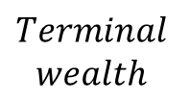

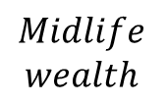
Sketch of wealth (W) and transfers (gifts, B) over life
$$Midlife$$
$$wealth$$
$$Terminal$$
$$wealth$$
Marriage
$$W_{l}$$
$$W_{d}$$
F
Death
$$W_{d}$$
Gen1
M
$$B$$
Death
$$B$$
Inter vivos gifts
$$W_{d}$$
Gen2
Death
$$W_{l}$$

Slide 7
#1: Intergenerational wealth mobility
and the role of inheritance
(with Adrian Adermon and Mikael Lindahl, 2015)

Slide 8
Starting point
Does personal wealth status persist over more than two generations?
How important is inheritance as a driver of this persistence?

Slide 9
Previous literature
Wealth mobility
  Two-generational IGEs: Menchik 1979; Charles and Hurst 2003; Wahl 2002; Britain: (Harbury and Hitchens 1979)
  Three-gen 0.1–0.3 (Wahl 2002; Arrondel and Grange 2006; Boserup et al 2014).
Multigenerational effects
  Importance of long-term social mobility over and above parents
    Lindahl et al. (2015), Clark and Cummins (2014), Boserup et al. (2014), Long and Ferrie (2013)
Role of inheritance in IG wealth mobility
  Adoptees in Sweden (Black et al, 2015)
  Korean adoptees in Norway (Mogstad et al, 2015).

Slide 10
Data (study population)
Survey of all third-graders in Sweden’s third largest city, Malmö, in 1938
Dataset used by several studies, e.g., Lindahl et al (2015).
Four linked generations
  Index generation (1928) + spouses
  Parents (1898)
  Children (1957)
  Grandchildren (1986)
Observe wealth, income, and education
LHS always individual; RHS always family

Slide 11
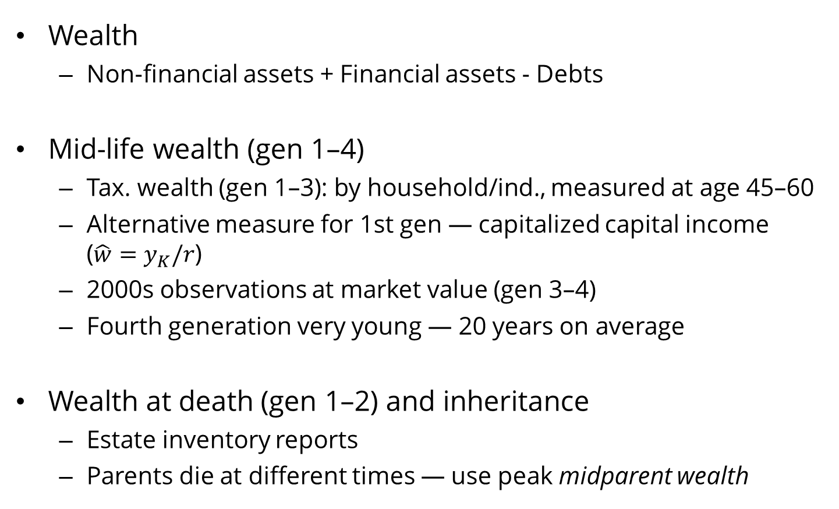
Wealth data
Wealth
  Non-financial assets + Financial assets - Debts
Mid-life wealth (gen 1–4)
  Tax. wealth (gen 1–3): by household/ind., measured at age 45–60
  Alternative measure for 1st gen — capitalized capital income ($\hat{w}=y_{K}/r$)
  2000s observations at market value (gen 3–4)
  Fourth generation very young — 20 years on average
Wealth at death (gen 1–2) and inheritance
  Estate inventory reports
  Parents die at different times — use peak midparent wealth

Slide 12
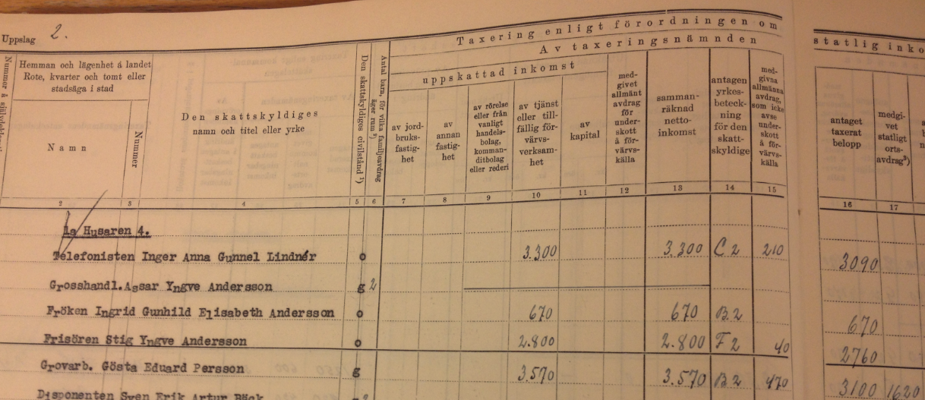

Data: Wealth in 1945 of generation 1
Wealth was taxed alongside income.
  $W_{s}=W/100$ was added to gross income $Y.$Then general deductions $D$ were subtracted to land at a reported taxable amount $A$.
  $$W=100∙W_{s}=100(A+D−Y)$$

Slide 13
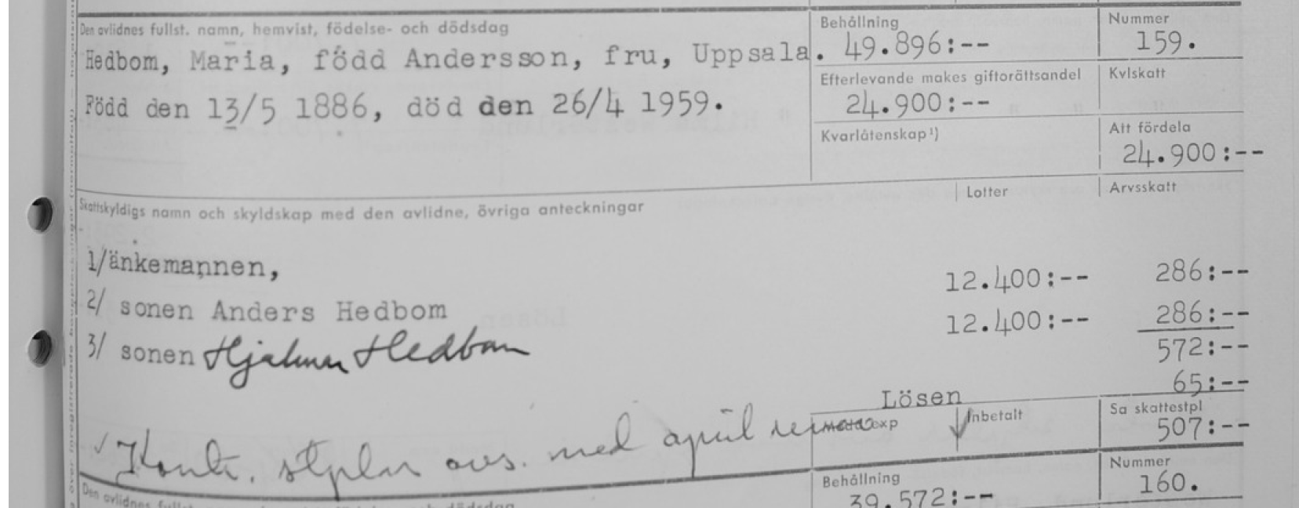
Data: Wealth at death (estate wealth), inheritance
Inheritance data:
  Inheritance tax reports: taxable inheritance lot $B$ (by heir).
Example of inheritance observation:
$$B$$
$$B$$
$$τ_{B}$$

Slide 14
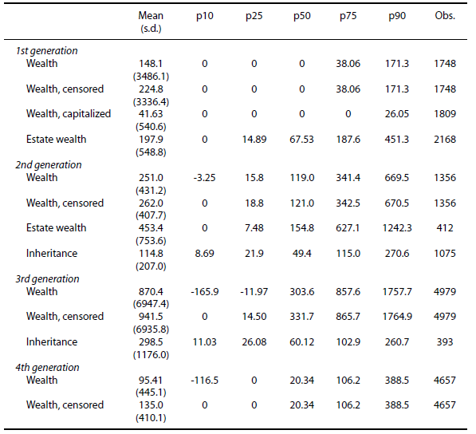
Descriptives

Slide 15
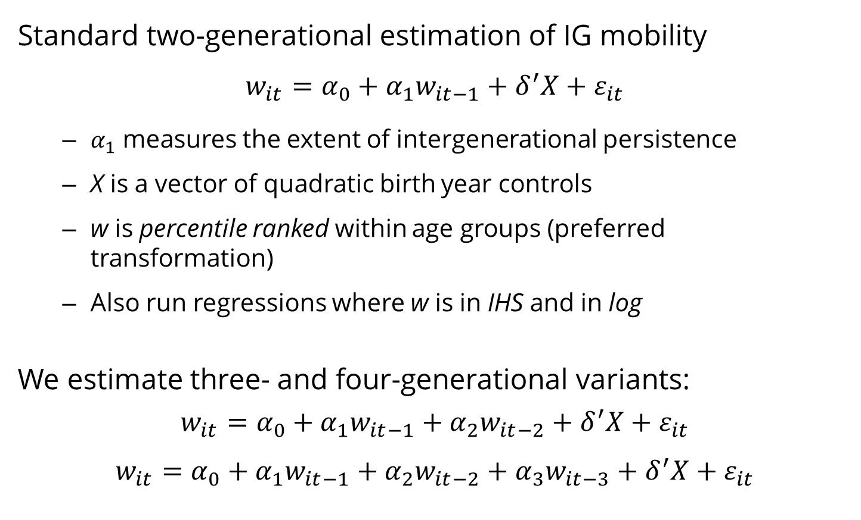
Estimating intergenerational wealth mobility
Standard two-generational estimation of IG mobility
$$w_{it}=α_{0}+α_{1}w_{it−1}+δ^{′}X+ε_{it}$$
  $α_{1}$ measures the extent of intergenerational persistence
  X is a vector of quadratic birth year controls
  w is percentile ranked within age groups (preferred transformation)
  Also run regressions where w is in IHS and in log
We estimate three- and four-generational variants:
$$w_{it}=α_{0}+α_{1}w_{it−1}+α_{2}w_{it−2}+δ^{′}X+ε_{it}$$
$$w_{it}=α_{0}+α_{1}w_{it−1}+α_{2}w_{it−2}+α_{3}w_{it−3}+δ^{′}X+ε_{it}$$

Slide 16
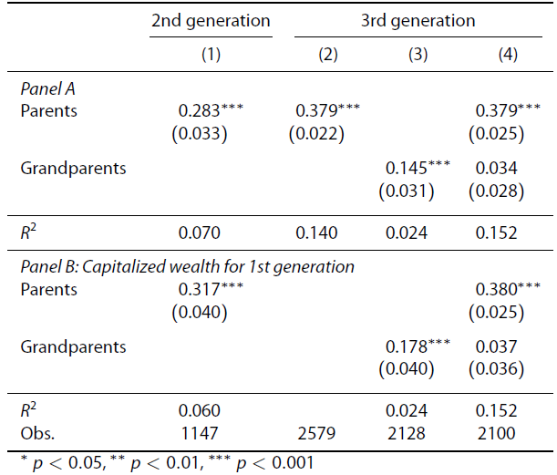
Wealth regressions: Main (wealth ranks)

Slide 17
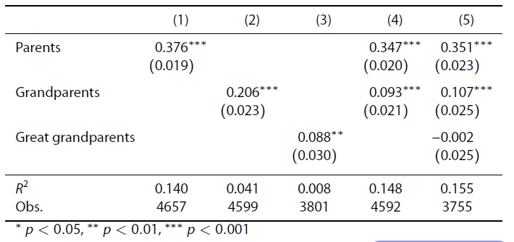
Four-generational persistence

Slide 18
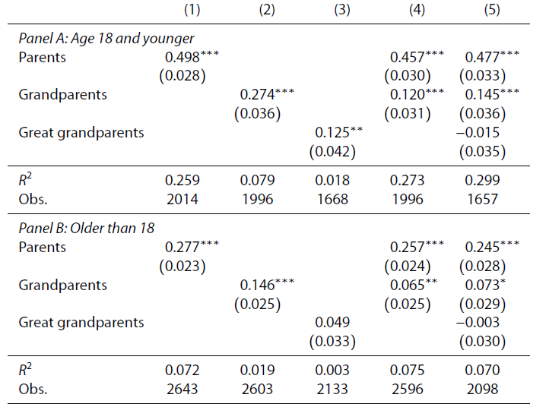
By age

Slide 19
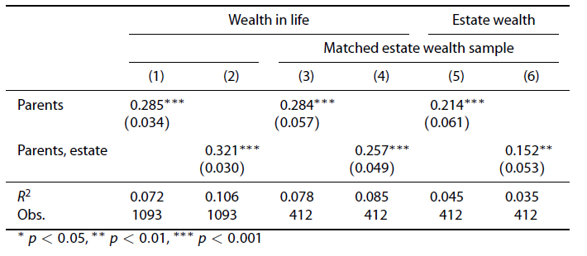
Life-cycle effects: Midlife vs Terminal W

Slide 20
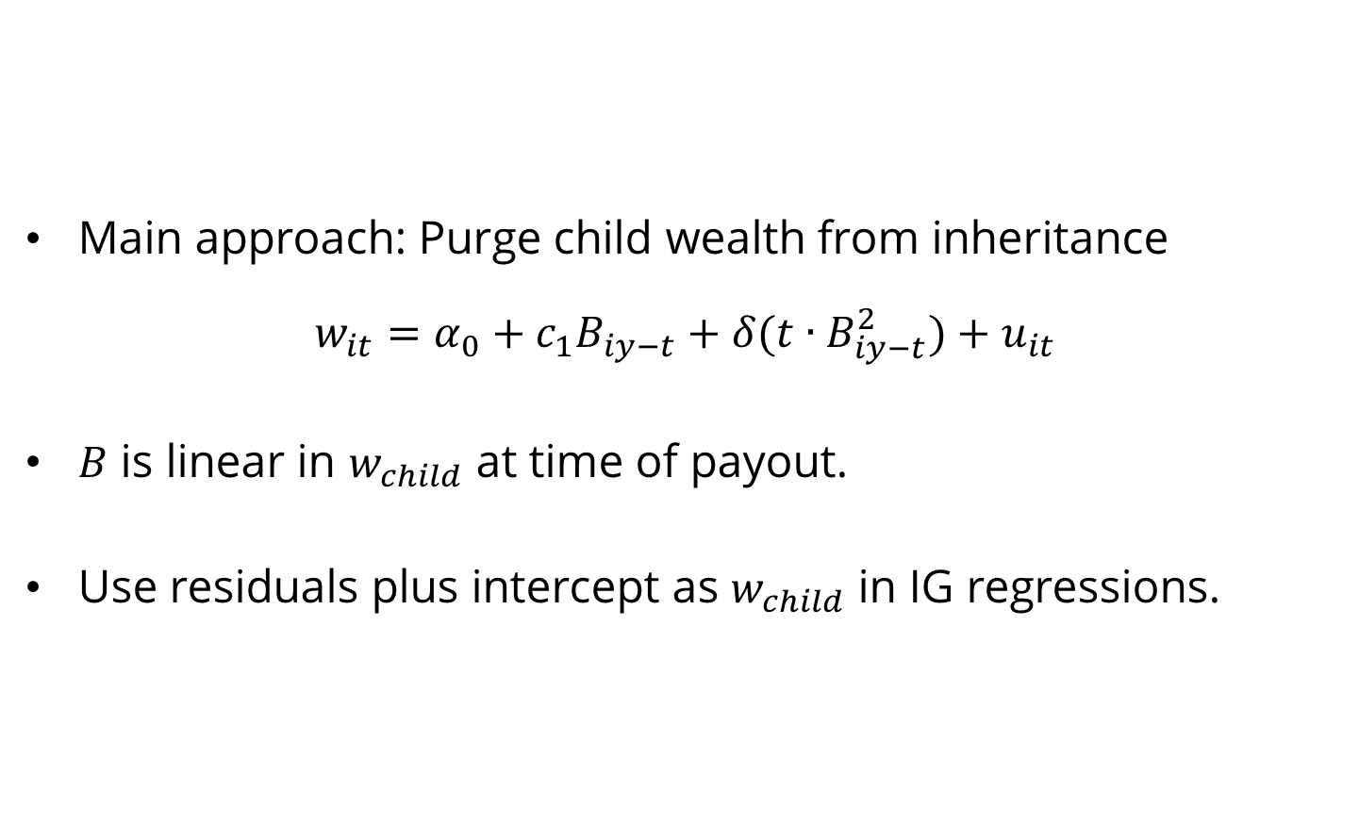
Estimating the role of inheritance
Main approach: Purge child wealth from inheritance
$$w_{it}=α_{0}+c_{1}B_{iy−t}+δ(t∙B_{iy−t}^{2})+u_{it}$$
$B$ is linear in $w_{child}$ at time of payout.
Use residuals plus intercept as $w_{child}$ in IG regressions.

Slide 21
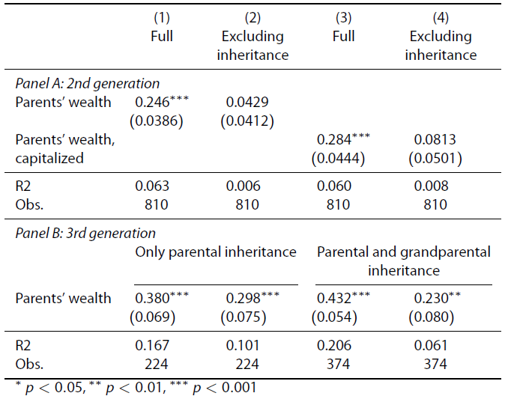
Role of inheritance: W without B

Slide 22
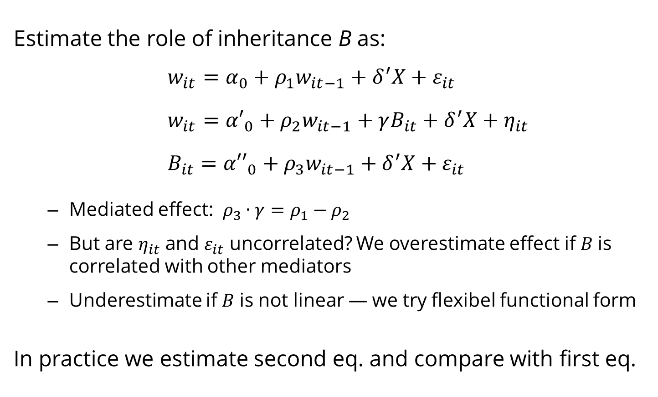
Estimate the role of inheritance B as:
$$w_{it}=α_{0}+ρ_{1}w_{it−1}+δ^{′}X+ε_{it}$$
$$w_{it}={α′}_{0}+ρ_{2}w_{it−1}+{γB_{it}+δ}^{′}X+η_{it}$$
$$B_{it}={α′′}_{0}+ρ_{3}w_{it−1}+δ^{′}X+ε_{it}$$
  Mediated effect: $ρ_{3}∙γ=ρ_{1}−ρ_{2}$
  But are $η_{it}$ and $ε_{it}$ uncorrelated? We overestimate effect if $B$is correlated with other mediators
  Underestimate if $B$ is not linear — we try flexibel functional form
In practice we estimate second eq. and compare with first eq.

Slide 23
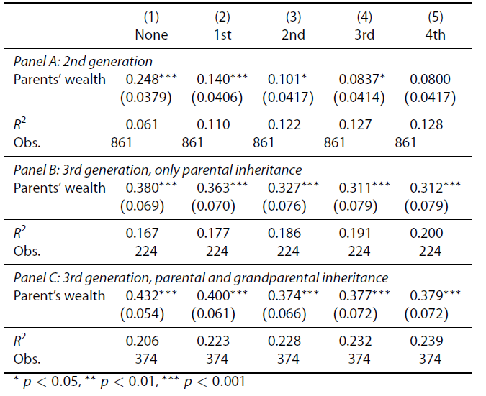
Role of inheritance: Flexible controls

Slide 24
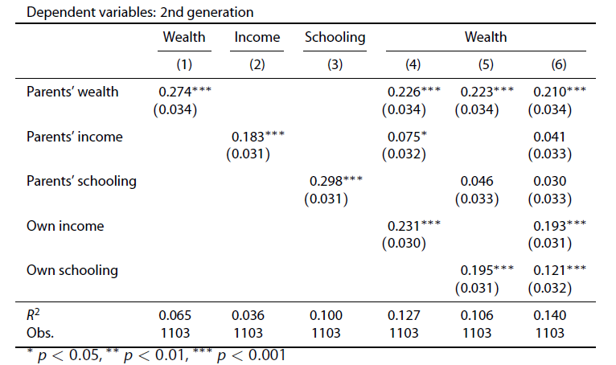
Role of other factors: Human capital, Skills

Slide 25
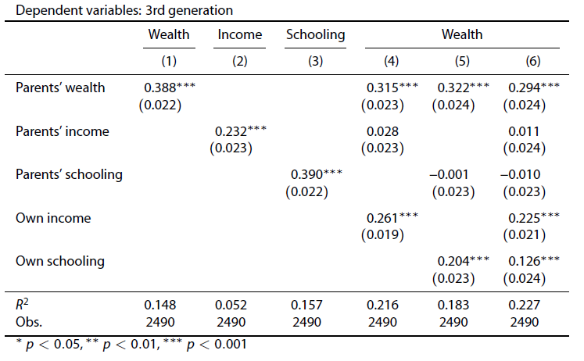
Role of other factors: Human capital, Skills

Slide 26
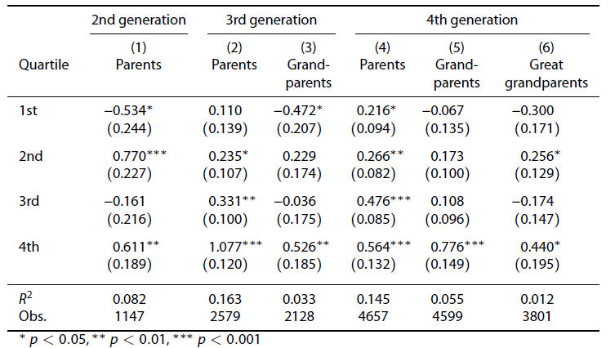
Nonlinearities: Spline regressions

Slide 27
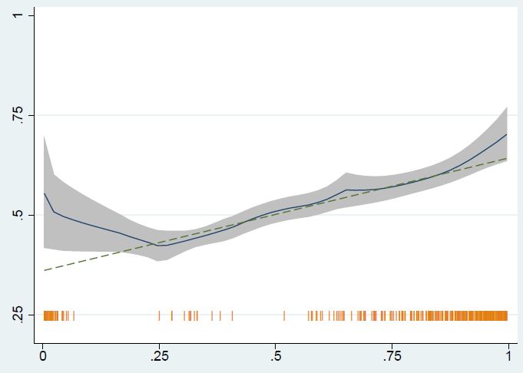
Non-linearities: 2nd Gen on 1st Gen

Slide 28
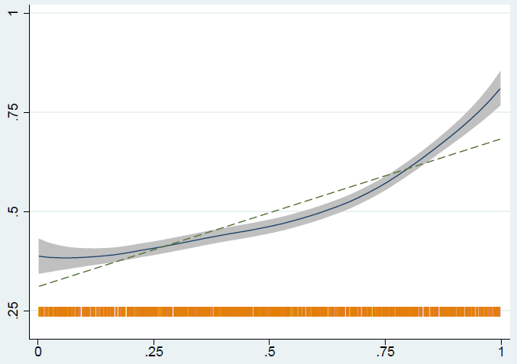
Non-linearities: 3rd Gen on 2nd Gen

Slide 29
Robustness checks
Results are (basically) robust to using:
Wealth censored at zero
Wealth in IHS, log and level
Adjusted taxable wealth values
Single wealth year for 2nd generation

Slide 30
Conclusions on IGW and inheritance
Main conclusions
  Most IG wealth transmission comes from parents; cannot reject AR(1)-type model
  Direct inheritances accounts for most (50–75 %) of the intergenerational wealth persistence
Additional contributions
  Mid-life wealth captures more transmission than terminal wealth
  Wealth persistence patterns visible even at young ages
  Non-linear relationship — more persistance in the top
  Some evidence of increasing persistence over time

Slide 31
#2: Inheritance and wealth inequality:
Evidence from register data
(with Mikael Elinder and Oscar Erixson, 2015)

Slide 32
Starting point
Wealth has become (somewhat) more unequally distributed
Flows of inherited wealth has increased
How do bequests influence the wealth distribution of heirs?
“...Inheritance perpetuates and may intensify inequalities arising originally from other causes. … The extent of its influence on distribution remains an open question, which cannot be decided merely by theoretical reasoning ... but requires in addition something in the nature of a quantitative analysis of the relevant facts.”
Wedgwood, 1929, pp. 60-61.

Slide 33
Earlier studies of inheritance and wealth inequality
Simulation evidence:
  Atkinson (1971), Davies & Shorrocks (1978): Real world wealth distribution more skewed than wealth distribution based on life-cycle wealth only. ⇒ Inheritance increases wealth inequality
  Blinder (1973): US parameters. ⇒ Ambiguous effect, mostly increasing
  Davies (1982): Canadian evidence ⇒ Inheritance major cause of W_ineq
Empirical evidence:
  Wolff (2003), Gittleman & Wolff (2014): SCF ⇒ Equalizing
  Klevmarken (2004): HUS data. ⇒ Equalizing
  Karagiannaki (2011): UK surveys. ⇒ Small, equalizing effect
  Crawford & Hood (2015). UK survey of elderly. ⇒ Equalize or no effect
  Boserup et al (2015). Danish register ⇒ Dis-equalizing effect

Slide 34
Population register data on inheritance
New Swedish database: All decedents and all their heirs
Inheritance years (cohorts): 2002−2005
Details about estates, inheritances (incl. 0’s), insurances, taxable gifts
  Problem: Undervaluation of some assets (e.g., family firms)
  Problem: Gifts (we only observe taxable gifts made in last 10 yrs)
Panel data on marketable net wealth of heirs
  Third party-reported. Excludes pension funds, unlisted firms
⇒ Leaves us with: 200,000 decedents and 600,000 heirs

Slide 35
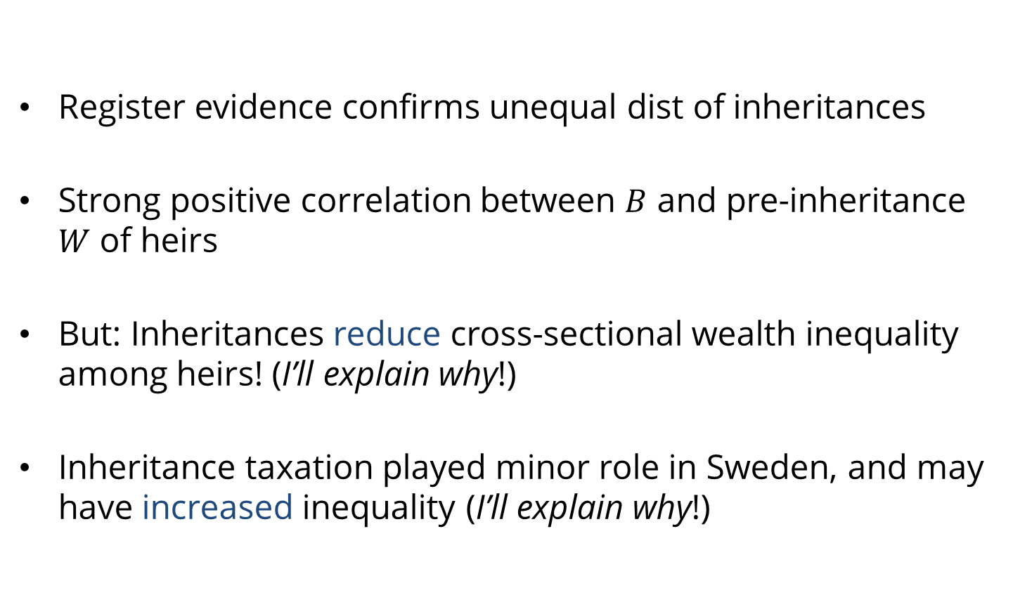
What we find
Register evidence confirms unequal dist of inheritances
Strong positive correlation between $B$ and pre-inheritance $W$ of heirs
But: Inheritances reduce cross-sectional wealth inequality among heirs! (I’ll explain why!)
Inheritance taxation played minor role in Sweden, and may have increased inequality (I’ll explain why!)

Slide 36
Causal effect
DiD approach:
  Compare evolution of wealth distributions across cohorts
We analyze cohorts:
  Presumption: Everybody inherits at some point in life (whether much or nothing)
  Cohorts of those who inherit vs. those who have not yet inherited
Counterfactual is thus not a world without inheritances

Slide 37
Descriptives of heirs
Cohort: | 2002 | 2003 | 2004 | 2005
Gross inheritance, in SEK | 82,520 | 83,430 | 88,791 | na
Net inheritance, in SEK | 73,025 | 73,737 | 78,131 | na
Paying inheritance tax | 0.329 | 0.330 | 0.342 | na
Net worth T-1 in SEK | 638,967 | 590,612 | 625,364 | 691,191
Taxable labor income T-1, in SEK | 220,041 | 224,993 | 227,687 | 234,903
Age at inheritance, years | 54.5 | 54.6 | 54.9 | 55.1
Woman | 0.507 | 0.505 | 0.507 | 0.506
Marital status
Married | 0.538 | 0.532 | 0.527 | 0.523
Education level
Primary | 0.308 | 0.295 | 0.290 | 0.280
Lower secondary | 0.436 | 0.441 | 0.444 | 0.449
Upper secondary or post- grad. | 0.246 | 0.254 | 0.257 | 0.262

Slide 38
Who inherits?
Cohort (% of heirs) | 2002 | 2003 | 2004 | 2005
Total class 1 | 62.7 | 63.3 | 61.8 | 65.1
Child | 56.7 | 57.1 | 55.6 | 59.4
Grandchild | 5.7 | 5.9 | 6 | 5.4
Great grandchild | 0 | 0 | 0.1 | 0
Total class 2 | 33.2 | 32.6 | 33.9 | 28.2
Father | 0.7 | 0.8 | 0.7 | 0.8
Mother | 1 | 1.1 | 1 | 1.1
Sibling | 9.1 | 9 | 8.9 | 8.2
Nephew/niece | 18.3 | 17.7 | 18.7 | 15
Grandchild of sibling | 2.9 | 3 | 3.3 | 2.4
Total class 3 | 0.1 | 0.1 | 0.1 | 0.1
Grandparents, uncles, aunts | 0 | 0 | 0 | 0
Others (foster child, stepchild) | 4.0 | 4.0 | 4.2 | 3.9
Number of observations | 162,207 | 159,292 | 150,914 | 150,414

Slide 39
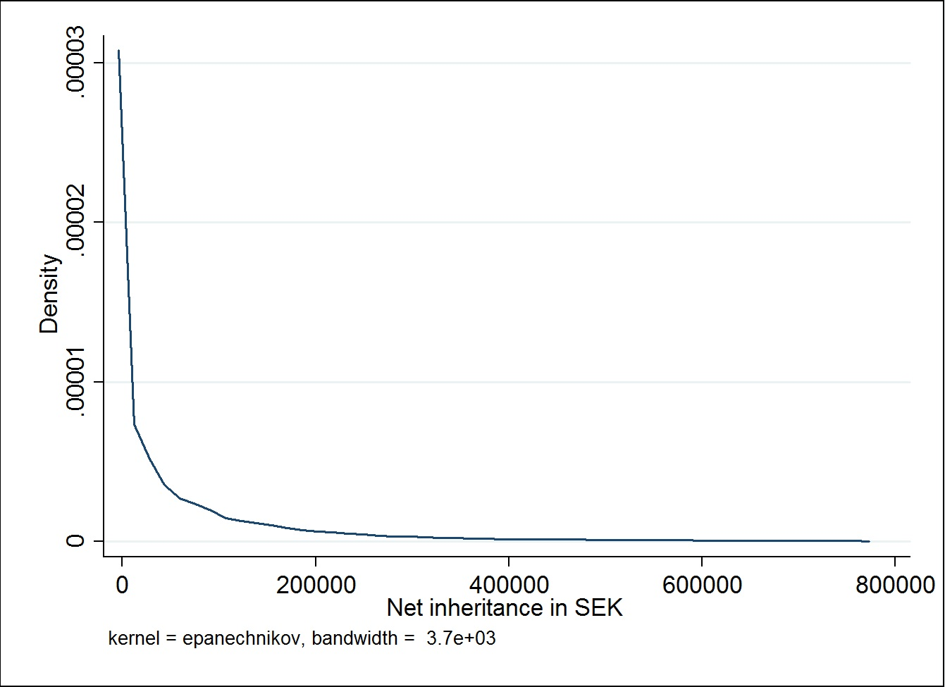
Distribution of inheritances

Slide 40
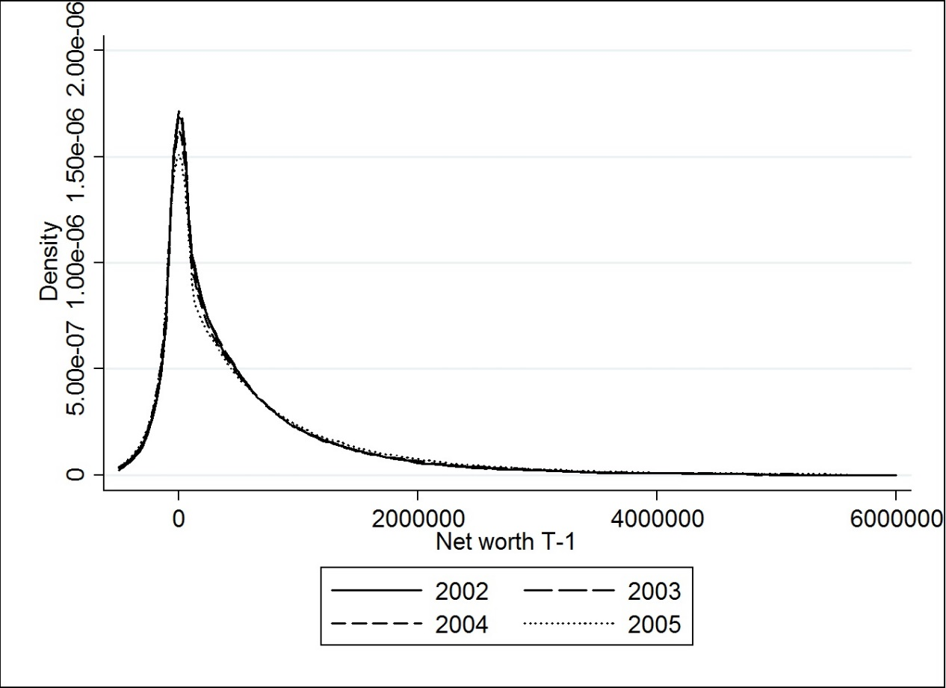
Distribution of wealth among heirs in t-1

Slide 41
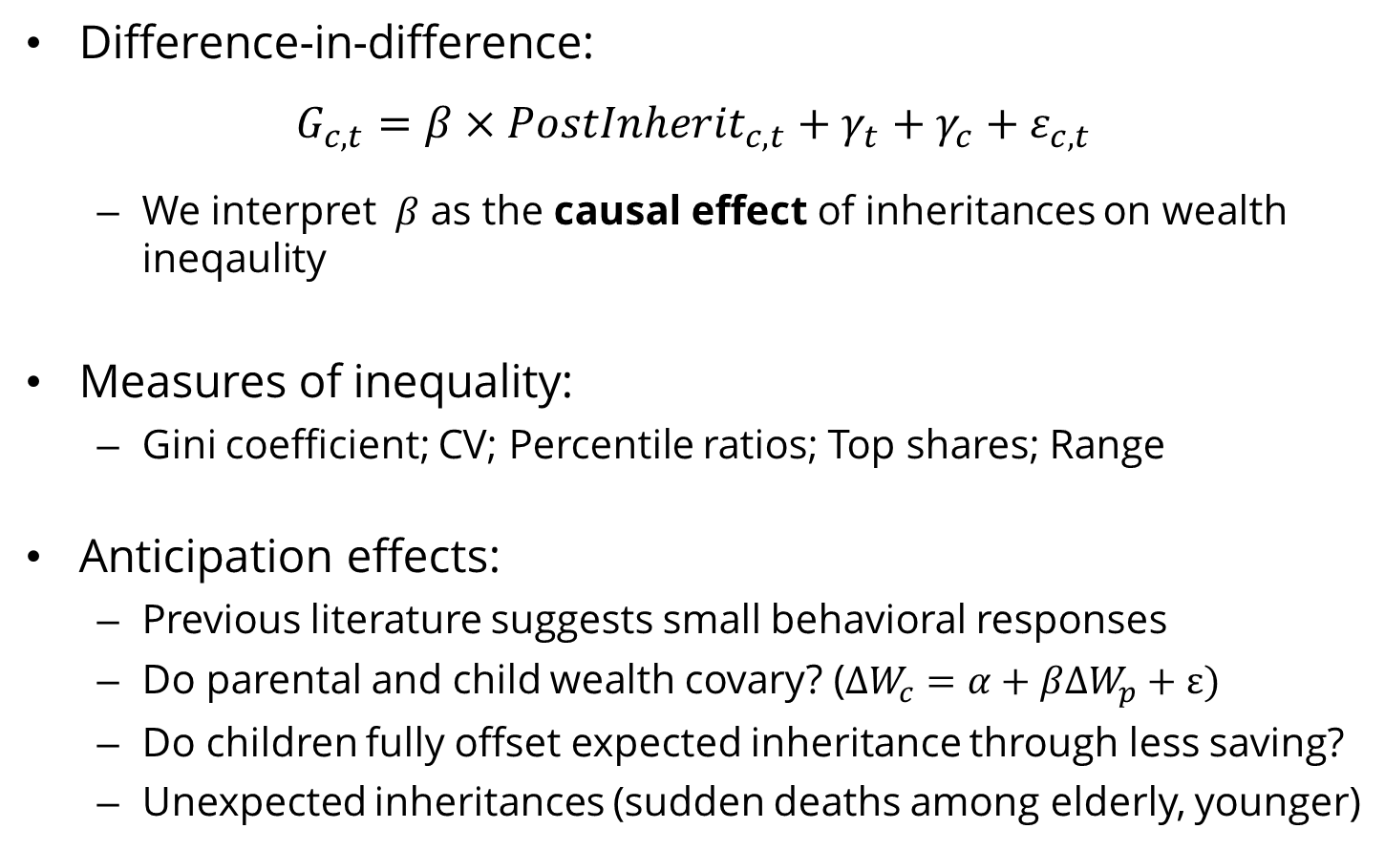
Identification
Difference-in-difference:
$$G_{c,t}=β×{PostInherit}_{c,t}+γ_{t}+γ_{c}+ε_{c,t}$$
  We interpret $β$ as the causal effect of inheritances on wealth ineqaulity
Measures of inequality:
  Gini coefficient; CV; Percentile ratios; Top shares; Range
Anticipation effects:
  Previous literature suggests small behavioral responses
  Do parental and child wealth covary? ($∆W_{c}=α+β∆W_{p}+ε)$
  Do children fully offset expected inheritance through less saving?
  Unexpected inheritances (sudden deaths among elderly, younger)

Slide 42
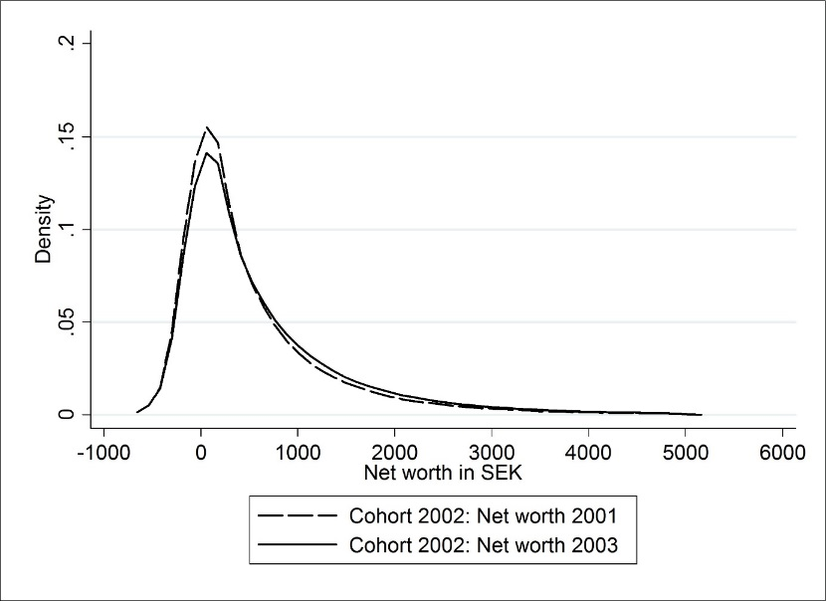

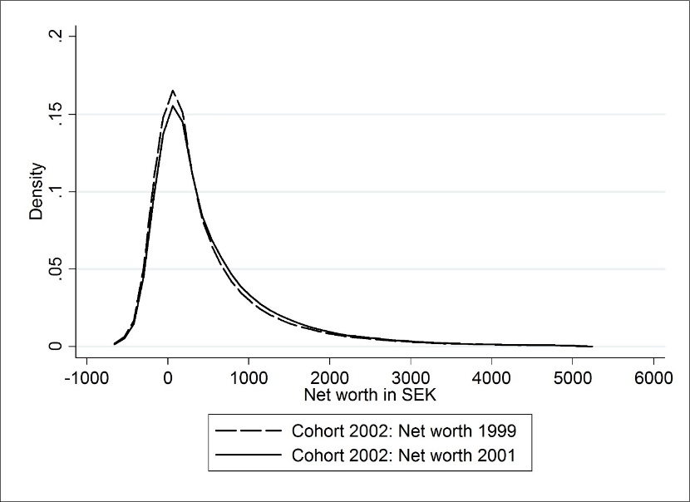
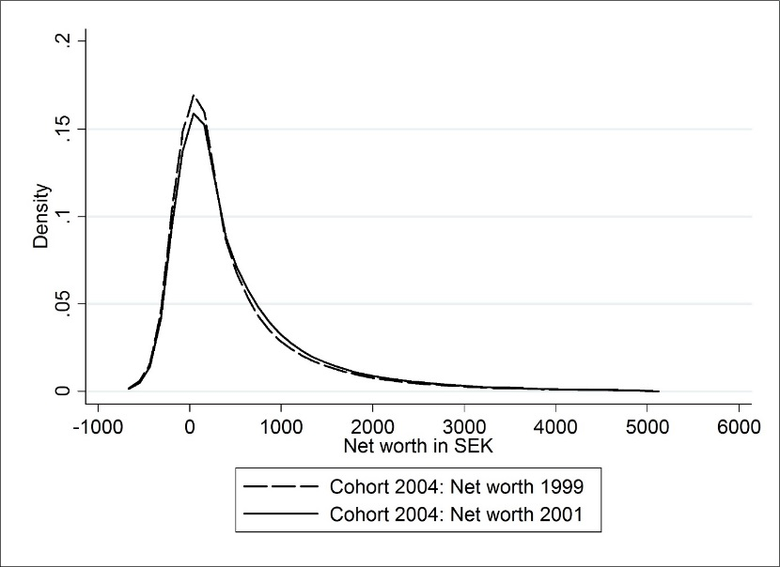
Results: Distributional graphical analysis
Inheritance + Macro + Cohort effects
No inheritance: Cohort 2004 in same years (t-3, t-1)
No inheritance: Cohort 2002 t-3, t-1
No inheritance: Cohort 2002 in same years (t-5, t-3)

Slide 43
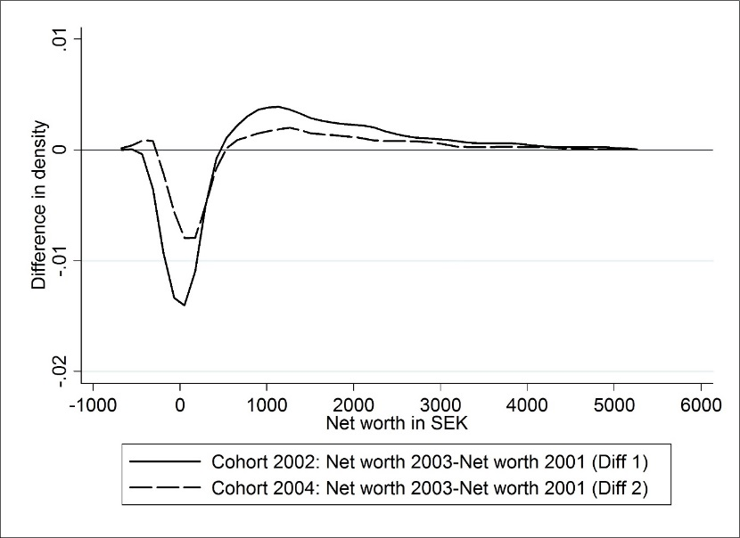
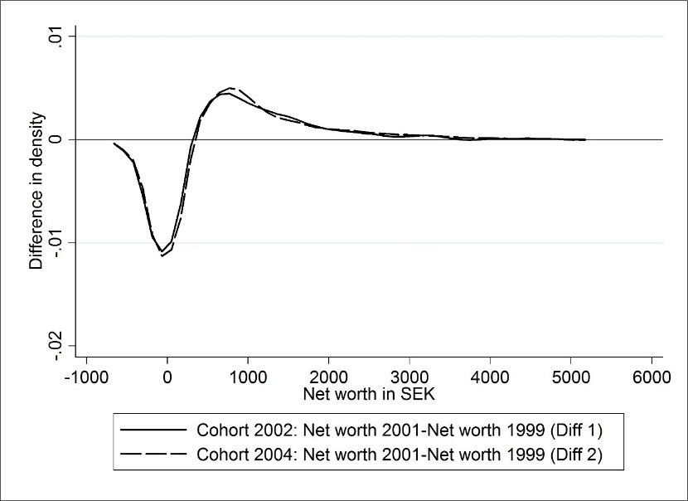
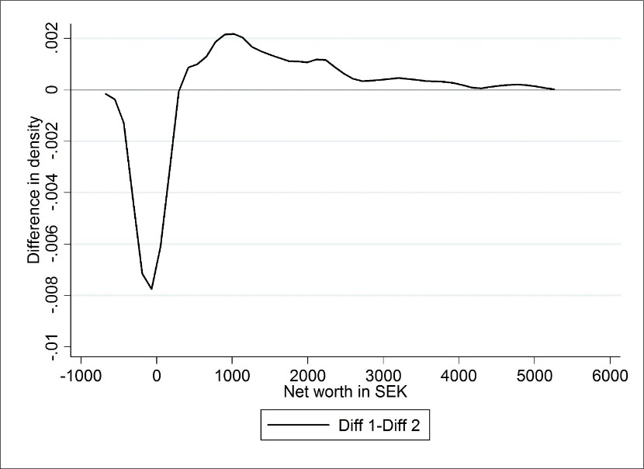
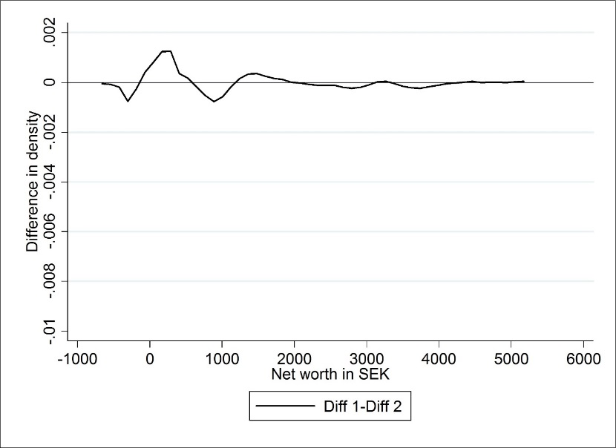
Distributional graphical analysis
Inheritance + Cohort effects (Macro removed)
No inheritance: DiD (placebo vs control)
Inheritance effect
No inheritance: Control

Slide 44
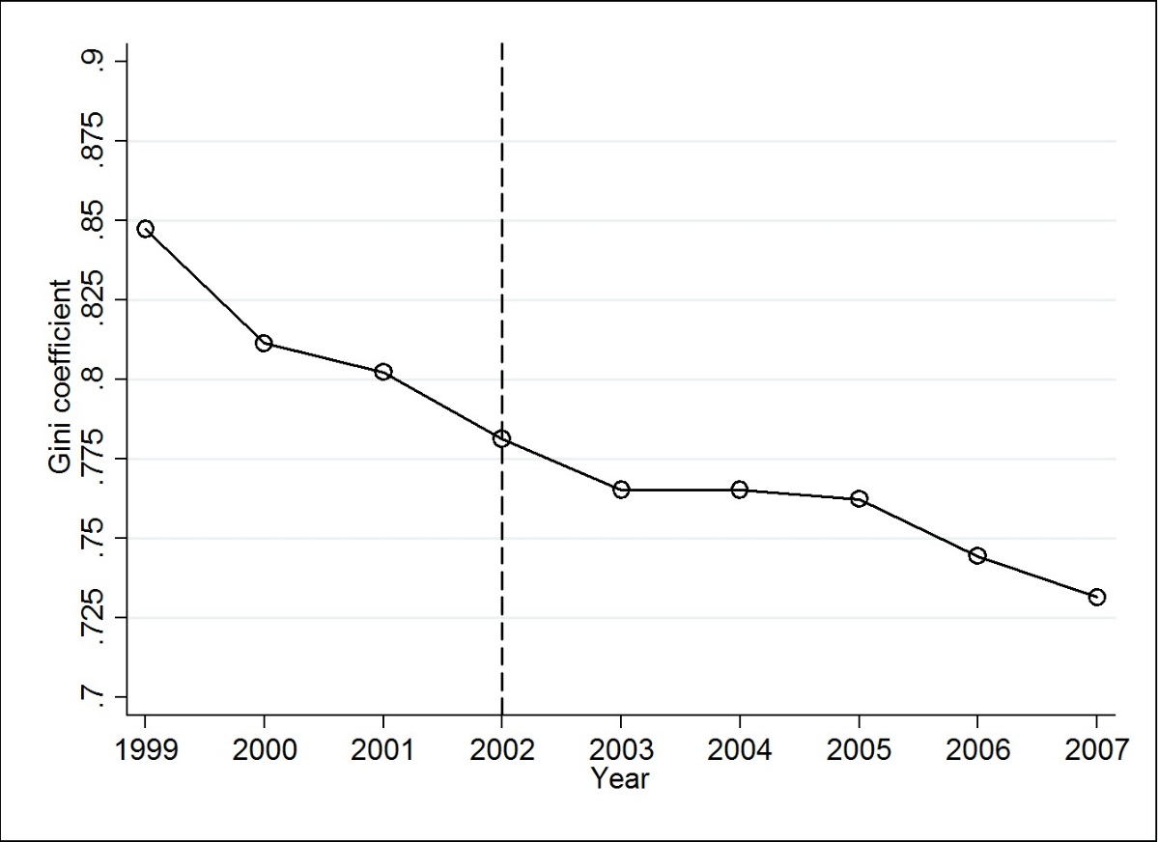
Wealth inequality effects
Wealth gini of heirs in 2002-cohort

Slide 45
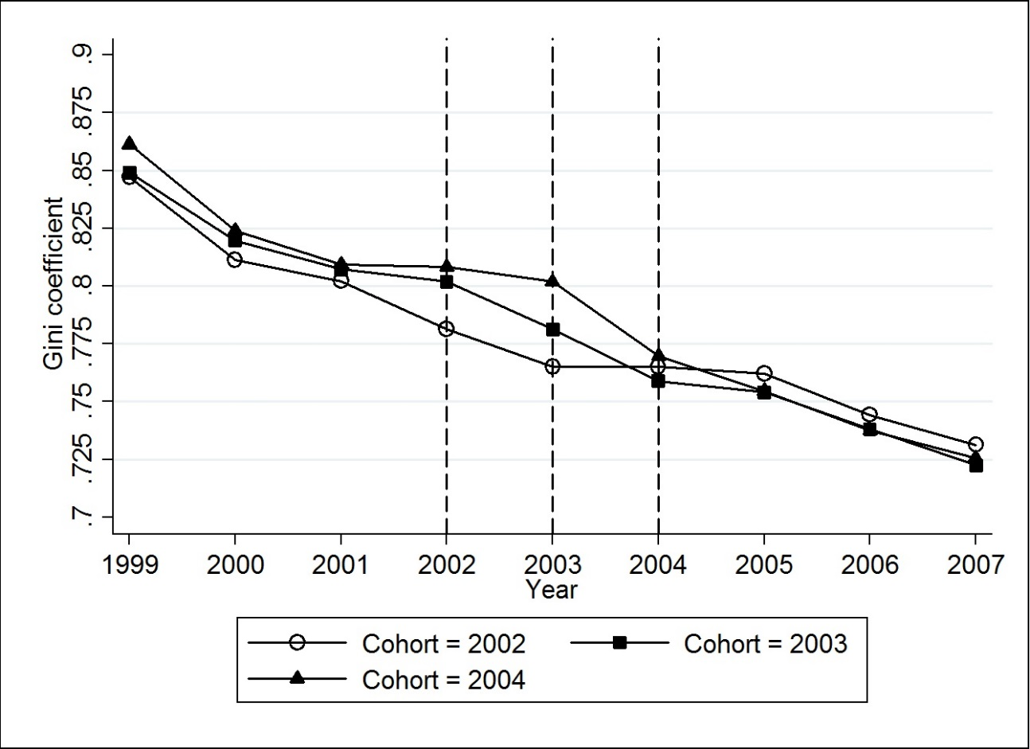
Wealth inequality effects
Wealth gini of heirs in 2002/2004-cohorts

Slide 46
DiD regression estimates: Main model
 | (1) | (2) | (3) | (4) | (5) | (6) | (7) | (8) | (9)
Outcome: | Gini | P90/P50 | P99/P50 | Top1% | Top10% | Bot. 50% | P75-P25 | P99-P1 | CV
Treatment | -0.035*** | -0.601*** | -1.876** | -0.023** | -0.029*** | 0.018*** | 64,998*** | 259,586* | -4.320
 | (0.008) | (0.163) | (0.831) | (0.010) | (0.004) | (0.005) | (15,484) | (128,255) | (3.007)
Ave in t-1 | 0.802 | 6.609 | 20.618 | 0.189 | 0.556 | -0.015 | 765,926 | 5,545,335 | 6.79
Effect in % | -4.36 | -9.10 | -9.10 | -12.70 | -5.21 | 120 | 8.49 | 4.68 | -63.62
R-squared | 0.992 | 0.992 | 0.988 | 0.947 | 0.996 | 0.987 | 0.999 | 0.998 | 0.647
Number of heirs | 472,413 | 472,413 | 472,413 | 472,413 | 472,413 | 472,413 | 472,413 | 472,413 | 472,413
Cohorts | 3 | 3 | 3 | 3 | 3 | 3 | 3 | 3 | 3
Obs | 24 | 24 | 24 | 24 | 24 | 24 | 24 | 24 | 24

Slide 47
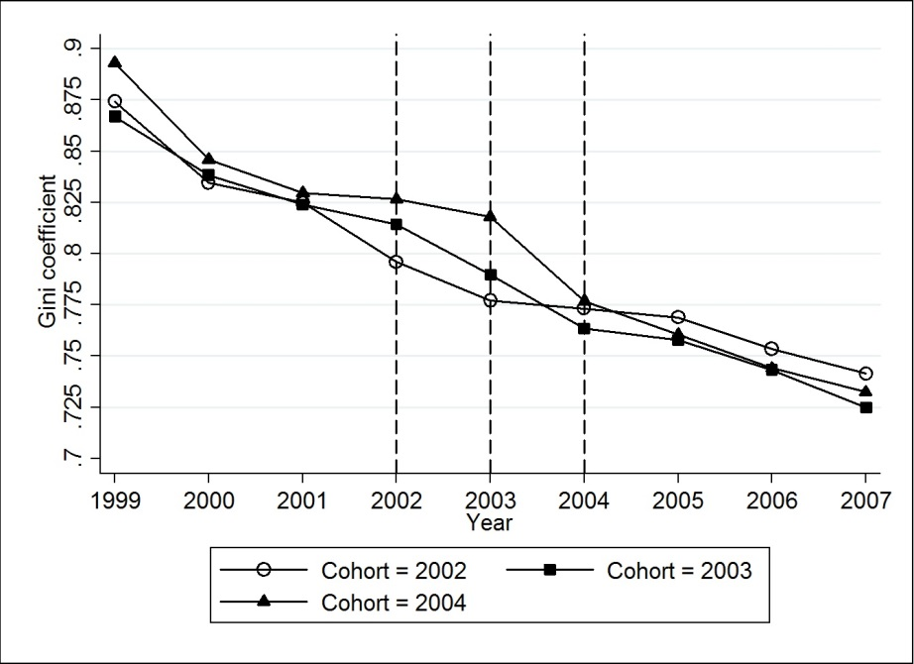
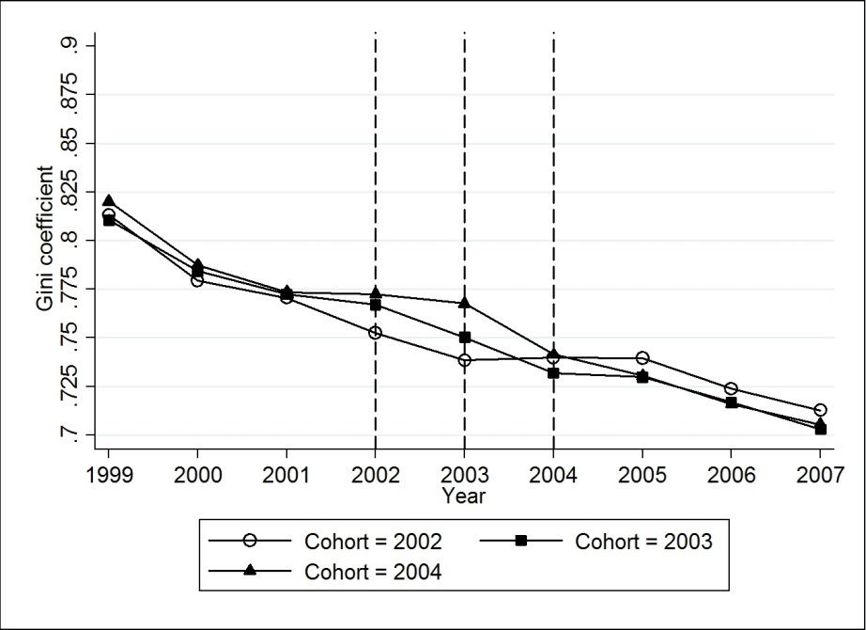
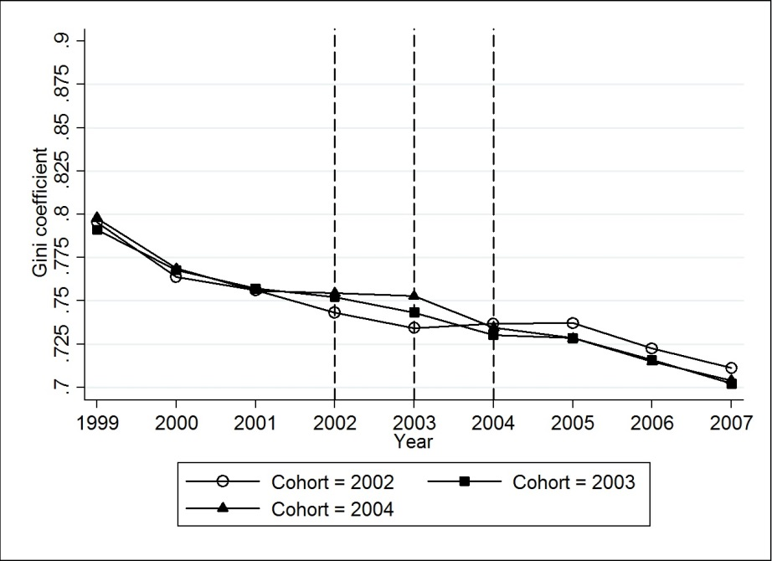
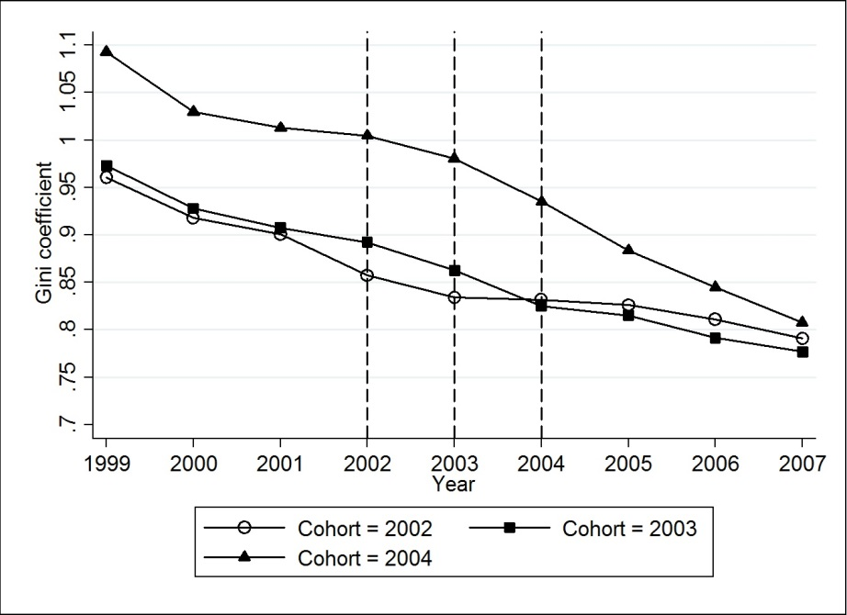
Robustness checks
Children-heirs only
Add consumer durables
Add ”expected” inheritance
Unexpected deaths

Slide 48
Robustness DiD regressions
 | (1) | (2) | (3) | (4) | (5)
Outcome: | Main | Children | Cons.dur. | Adding future inh. | Unexp. death (”younger”)
Treatment | ‒0.035*** | ‒0.039*** | ‒0.031*** | ‒0.021*** | ‒0.067*
 | (0.008) | (0.010) | (0.006) | (0.005) | (0.036)
Mean of outcome t-1 | 0.802 | 0.819 | 0.769 | 0.754 | 0.924
Effect in % | -4.4 | -4.7 | -4.0 | -2.9 | -7.3
R-squared | 0.992 | 0.991 | 0.993 | 0.993 | 0.950
Number of heirs | 472,413 | 266,917 | 472,413 | 472,413 | 22,129
Cohorts | 3 | 3 | 3 | 3 | 3
Observations | 24 | 24 | 24 | 24 | 24

Slide 49
Mechanism analysis
What explains the finding that inheritances reduce wealth inequality?
Two candidates:
  The rich have more children
  Inheritances are relatively more important lower down the distribution

Slide 50
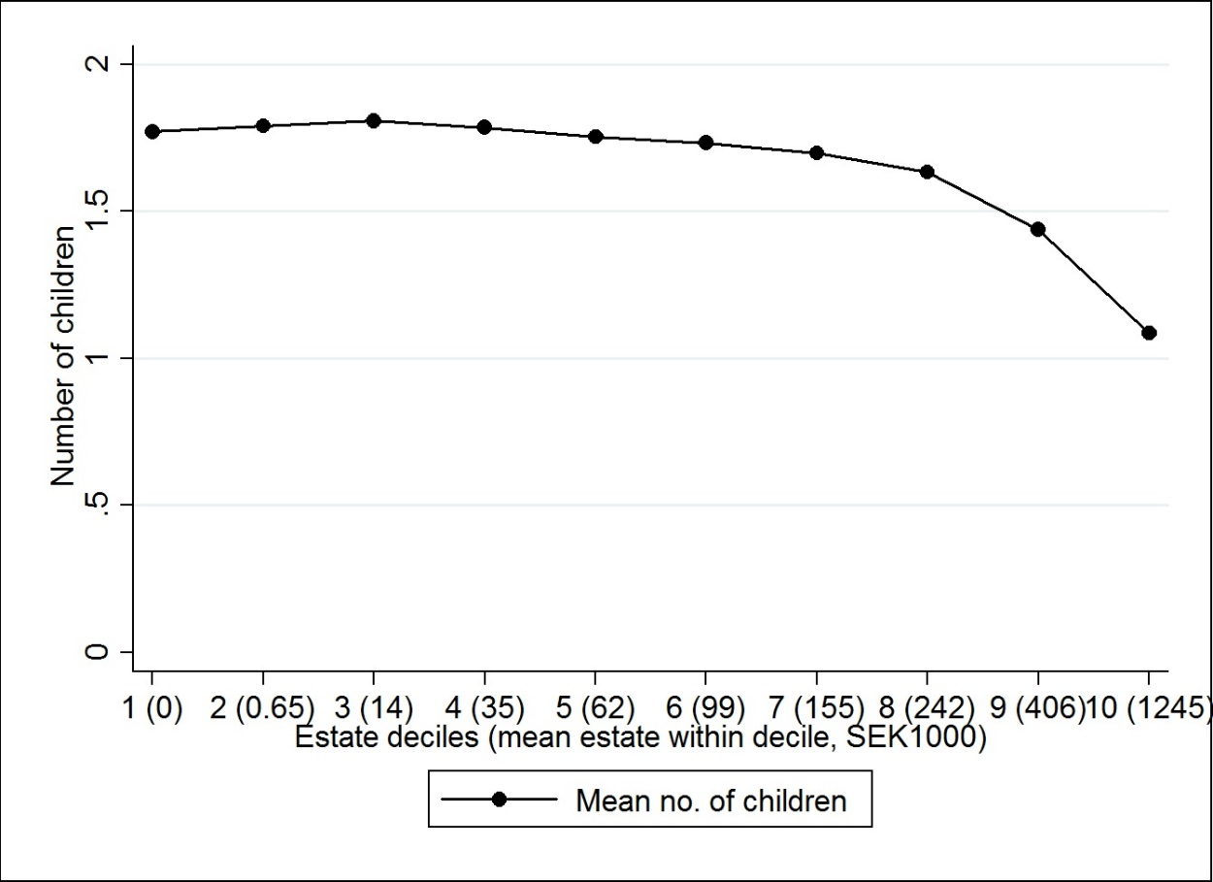
Do the rich have more children?
Number of children by estate size

Slide 51
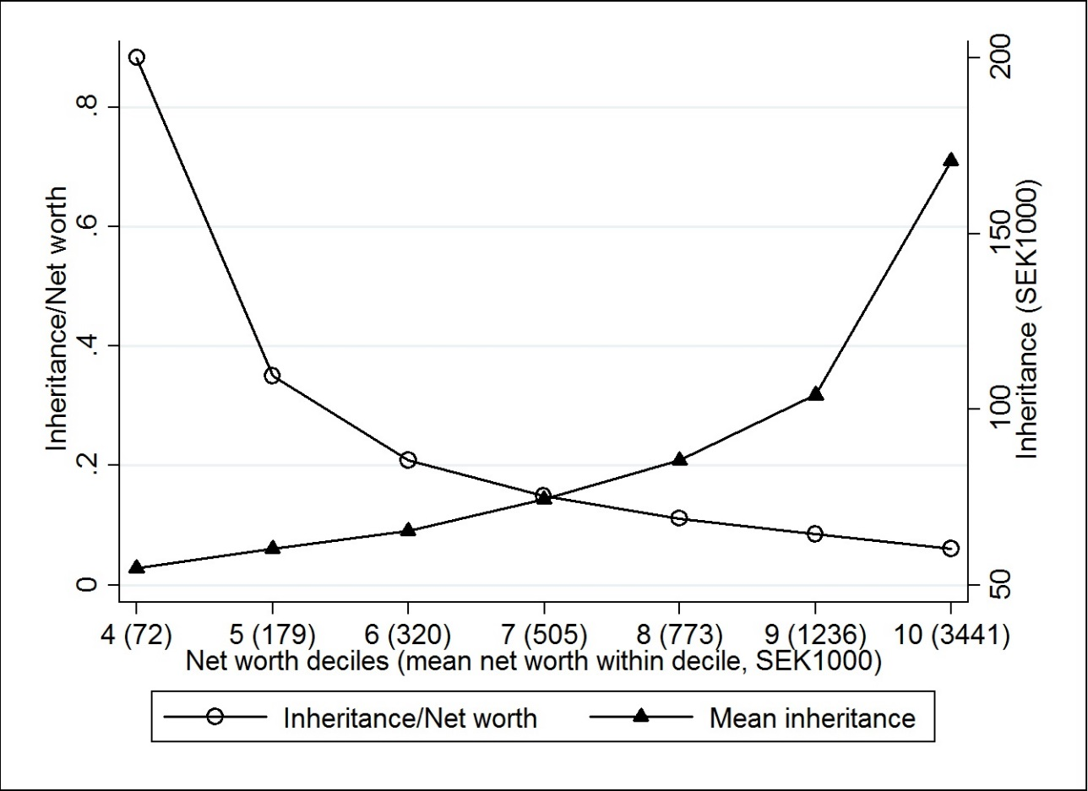
Bequests relatively more important in the bottom
Mean inheritance and inheritance/wealth across heirs wealth deciles
Relatively more
important in the bottom
Absolutely more
important in the top

Slide 52
Inheritance taxation: Did it matter in Sweden?
Progressive tax rate: 0, 10, 20, and 30 percent
  But, the average, effective tax rate was rarely above 20 percent
Finding: The tax may actually have contributed to increased wealth inequality among heirs
Caveats:
  A more progressive tax may yield a different result
  Does not account for redistribution of inheritance tax revenues
  Does not account for popular sentiments towards equalization

Slide 53
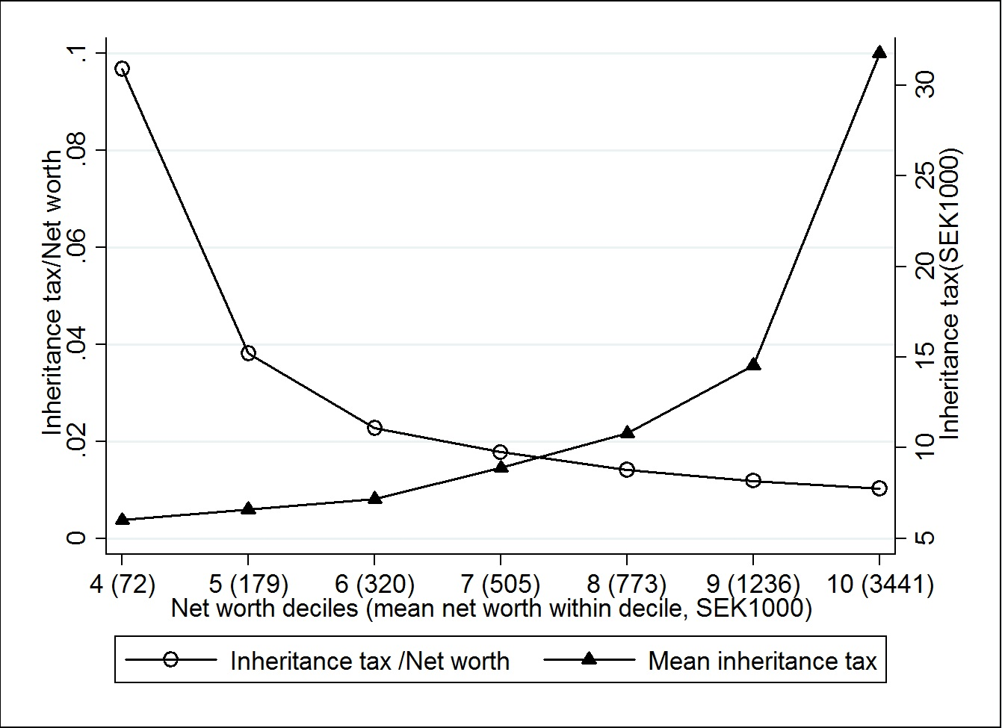
How can a progressive inheritance tax increase wealth inequality?
Figure: Inheritance tax payments by wealth decile

Slide 54
Extensions
Alternative counterfactuals
  100% inheritance tax
  Progressive redistributions of the inheritance tax
  Look at full population (incl not year heirs and previous heirs)
    Similar to survey evidence
Lifetime resources
  Inequality of material wealth is just one distributional outcome
  Lifetime Resources = Lifetime earnings + Bequests and gifts
    Estimate lifetime earnings and add inheritance

Slide 55
Concluding ”Inheritance and wealth inequality”
Positive correlation between bequests and wealth of heirs
  Richer heirs inherit more, absolute variation increases
But inheritances reduce wealth inequality
  Confirms results in survey data
  Results robust to tests for undervalued wealth, gifts, expectations
Limitations/Need for more analysis:
  Cannot perfectly account for pre-inheritance responses
  …or the impact of all inter vivos gifts
  Distinguish between lifecycle and inherited wealth of donees?
  Normative inheritance tax analysis?

Slide 56
Extra slides

Slide 57
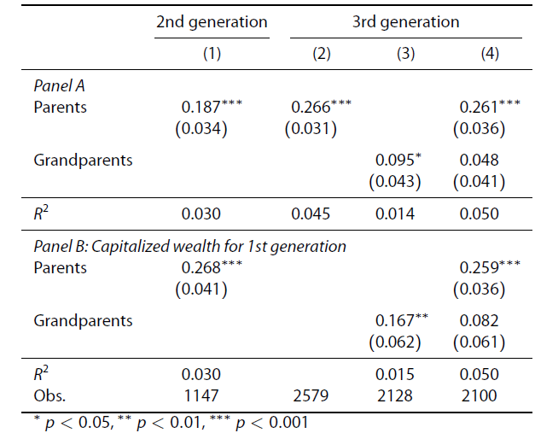
Wealth regressions: IHS

Slide 58
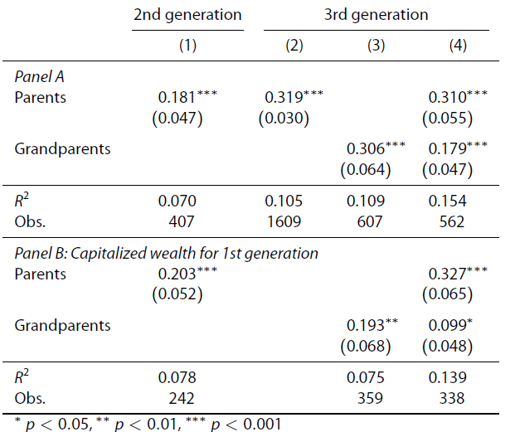
Wealth regressions: log Wealth

Slide 59
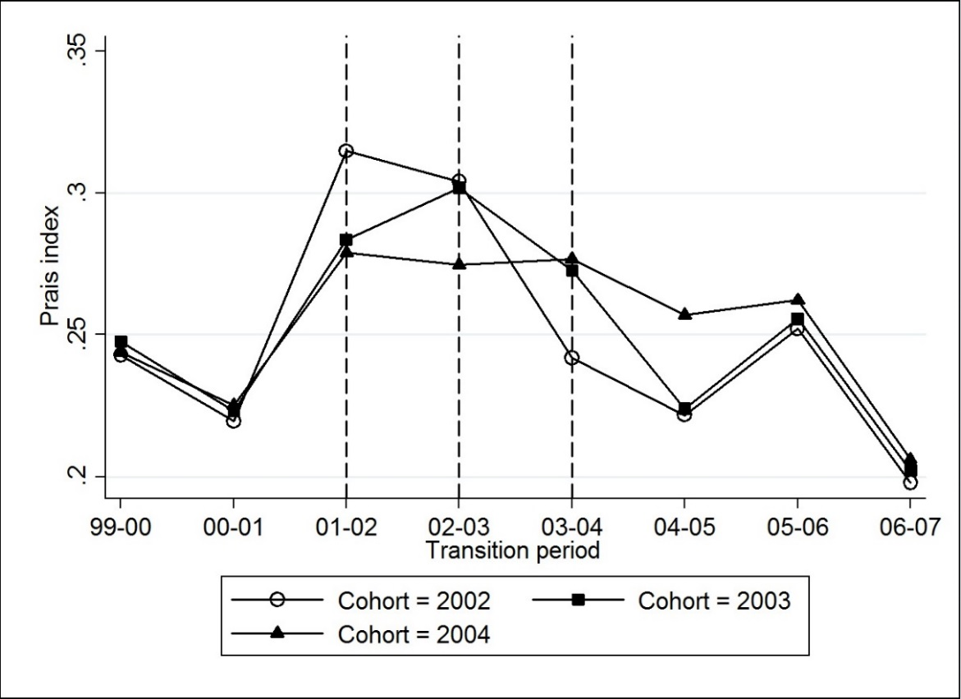
Mobility effects
Evolution of Shorrocks-Prais index (trace in tr.matrices)

Slide 60
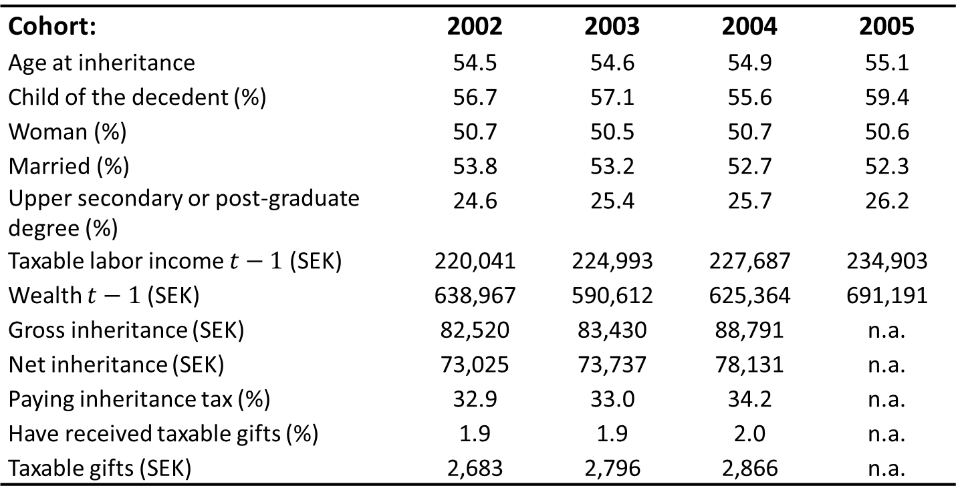
Descriptives of heirs
Cohort: | 2002 | 2003 | 2004 | 2005
Age at inheritance | 54.5 | 54.6 | 54.9 | 55.1
Child of the decedent (%) | 56.7 | 57.1 | 55.6 | 59.4
Woman (%) | 50.7 | 50.5 | 50.7 | 50.6
Married (%) | 53.8 | 53.2 | 52.7 | 52.3
Upper secondary or post-graduate degree (%) | 24.6 | 25.4 | 25.7 | 26.2
Taxable labor income $t−1$ (SEK) | 220,041 | 224,993 | 227,687 | 234,903
Wealth $t−1$ (SEK) | 638,967 | 590,612 | 625,364 | 691,191
Gross inheritance (SEK) | 82,520 | 83,430 | 88,791 | n.a.
Net inheritance (SEK) | 73,025 | 73,737 | 78,131 | n.a.
Paying inheritance tax (%) | 32.9 | 33.0 | 34.2 | n.a.
Have received taxable gifts (%) | 1.9 | 1.9 | 2.0 | n.a.
Taxable gifts (SEK) | 2,683 | 2,796 | 2,866 | n.a.

Slide 62
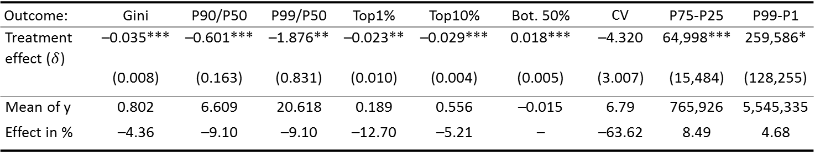
Inheritance effects on wealth inequality
Outcome: | Gini | P90/P50 | P99/P50 | Top1% | Top10% | Bot. 50% | CV | P75-P25 | P99-P1
Treatment effect ($δ$) | –0.035*** | –0.601*** | –1.876** | –0.023** | –0.029*** | 0.018*** | –4.320 | 64,998*** | 259,586*
 | (0.008) | (0.163) | (0.831) | (0.010) | (0.004) | (0.005) | (3.007) | (15,484) | (128,255)
Mean of y | 0.802 | 6.609 | 20.618 | 0.189 | 0.556 | –0.015 | 6.79 | 765,926 | 5,545,335
Effect in % | –4.36 | –9.10 | –9.10 | –12.70 | –5.21 | – | –63.62 | 8.49 | 4.68
The direct mechanical effect on Gini: 6 percent reduction

Slide 63
Development of the Gini coefficient
2002 cohort inherits
2003 cohort inherits
2004 cohort inherits

Slide 64
Why do inheritances reduce wealth inequality?
‒ Relatively more important for the less wealthy!
Figure: Inheritance by wealth deciles
Relatively more
important in the bottom
Absolutely more
important in the top

Slide 65
Sensitivity analysis
Different inequality measures (CV, Top shares, Percentile ratios):
  Ineq. effect decreases, but dispersion increases
Adjusting for (potential) undervaluation of assets (e.g., tax-assessed values of housing, consumer durables)
Restricting analysis to children-heirs
Adding estimated (unobserved) gifts: Larger effect
Expectations on pre-inheritance wealth accumulation

Slide 66
What was the role of the Swedish inheritance tax?
Progressive tax: 0, 10, 20, and 30%.
  But, the average, effective tax rate was rarely above 20 percent
Finding: The tax may actually have contributed to increased wealth inequality among heirs!
Caveats:
  A more progressive tax may yield a different result
  Does not account for redistribution of inheritance tax revenues
  Does not account for popular sentiments towards equalization

Slide 67
How can a progressive inheritance tax increase wealth inequality?
Figure: Inheritance tax payments by wealth decile

Slide 68
Role of inheritance taxation
Sweden's inheritance tax quite modest in the 2000s
  Top marginal tax rate at 30 percent
  Very large discounts on inherited business equity (family firms)
Distribution of inheritances gross and net of inheritance tax
 | Mean | P99 | P90 | P50 | P25 | P1 | Gini
Gross inheritance | 82,872 | 889,826 | 212,927 | 14,873 | 0 | 0 | 0.789
Net inheritance | 73,558 | 750,107 | 195,628 | 14,864 | 0 | 0 | 0.774

